Slide 1

WELCOME
to the
Intrastate New Entrant
Safety Seminar

Slide 2

RESTROOMS

Slide 3
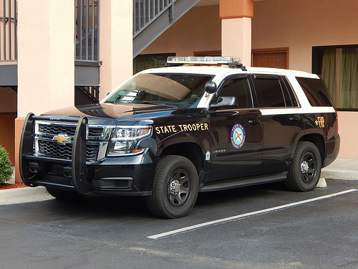
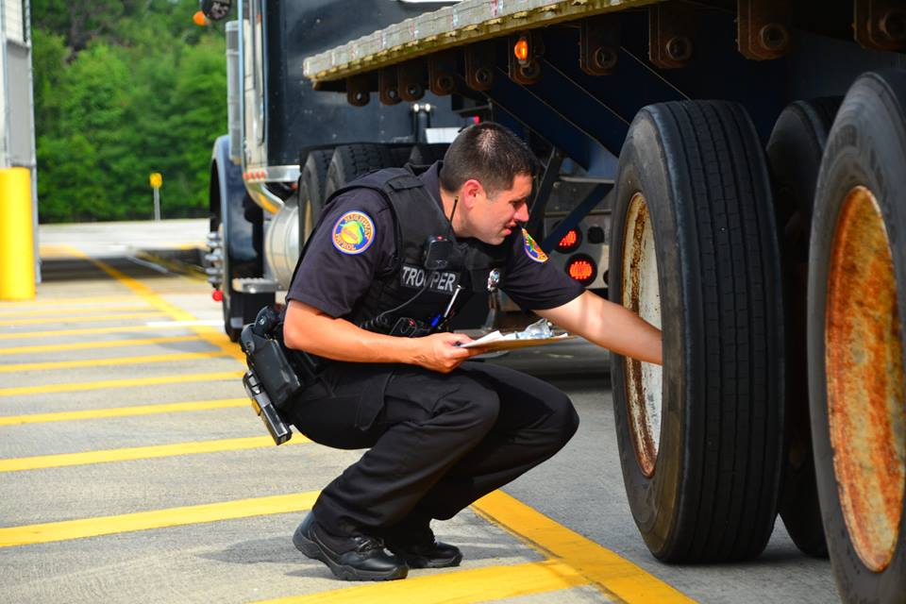
A COPY OF THIS PRESENTATION CAN BE FOUND ON THE FHP COMMERCIAL VEHICLE ENFORCEMENT WEBPAGE AT:
https://www.flhsmv.gov/florida-highway-patrol/specialized-areas/commercial-vehicle-enforcement

Slide 4

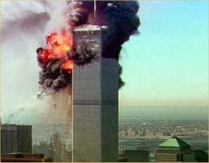
SEPTEMBER 11, 2001
Never Forget!

Slide 5
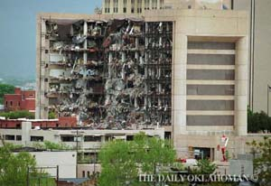
April 19, 1995 - Oklahoma City

Slide 6
Commercial Vehicle Drivers
STAY ALERT!
Report suspicious activities to local law enforcement officials, or call the FDLE Domestic Security hotline:
800-342-0820
Motor Carriers
FDLE History information available online:
http://fdle.state.fl.us/criminalhistory/

Slide 7


Truckers Against Trafficking is raising up a mobile army of transportation professionals to assist law enforcement in the recognition and reporting of human trafficking, in order to aid in the recovery of victims and the arrest of their perpetrators.
https://truckersagainsttrafficking.org/

Slide 8
The New Entrant Safety Seminar
is not
a Comprehensive Training Program on the
Federal Motor Carrier Safety Regulations, or
Florida State Statutes, but a general overview of the requirements of motor carriers operating in intrastate commerce within Florida.
Furthermore, the purpose of this seminar
is not
to provide legal advice, but to offer general information on regulatory requirements.

Slide 9
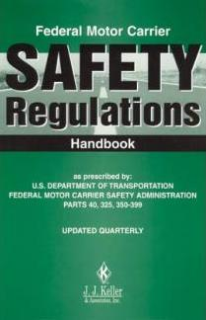
THE PURPOSE IS TO ASSIST MOTOR CARRIERS IN LEARNING:
Their safety responsibilities
The requirements of compliance
  with applicable regulations
How to obtain more
  information

Slide 10
DEFINITIONS
New Entrant: Motor carrier that applies for a USDOT identification number in Florida in order to initiate intrastate operations within the state of Florida.
Motor Carrier: A For-Hire motor carrier, or a private motor carrier -- including a motor carrier’s agents, officers, and representatives, as well as employees.
For-Hire Motor Carrier: Company engaged in the transportation of goods or passengers for compensation.
Private Motor Carrier: Company that provides transportation of property or passengers by commercial motor vehicle, and is not a for-hire motor carrier.

Slide 11
DEFINITIONS CONTINUED
Commercial Motor Vehicle: Any self-propelled or towed vehicle used on the public highways in commerce to transport passengers or cargo, if such vehicle:
(a) Has a gross vehicle weight rating of 10,000 pounds or more;
(b) Is designed to transport more than 15 passengers, including the driver;
(c) Is used in the transportation of materials found to be hazardous
Bus: Any motor vehicle designed for carrying more than 10 passengers and used for the transportation of persons and any motor vehicle, other than a taxicab, designed and used for the transportation of persons for compensation.
Non-public Sector Bus: Any bus which is used for the transportation of persons for compensation and which is not owned, leased, operated, or controlled by a municipal, county, or state government or a governmentally owned or managed nonprofit corporation.

Slide 12
DEFINITIONS CONTINUED
GVW: Gross Vehicle Weight – Actual vehicle weight.
GVWR: Gross Vehicle Weight Rating – Manufacture’s weight rating provided on the VIN plate of the vehicle.
GCWR: Gross Combined Weight Rating – Combined manufacture’s weight rating provided on the VIN plate of all vehicles in a combination.
*If the VIN plate is missing from a vehicle the actual weight (GVW) will be used in place of the GVWR.

Slide 13
FLORIDA STATE STATUTE 316.302
Outlines everything that a carrier must abide by when operating a CMV within the state of Florida.
Describes what FMCSRs (Federal Regulations) must be followed and gives guidance on applicable State Laws, including hours of service.
Provides exemptions for certain vehicles and/or carriers
  Agriculture Operations
  Vehicles with a GVW, GVWR, and GCWR of 26,000 lbs. or less
http://www.leg.state.fl.us/statutes/index.cfm?App_mode=Display_Statute&Search_String=&URL=0300-0399/0316/Sections/0316.302.html

Slide 14
INTRASTATE VS. INTERSTATE
This is determined by cargo and intent of the load.
Typically, loads with a bill of lading showing an origin/destination inside of the state of Florida will be considered intrastate.
Typically, loads with a bill of lading showing an origin/destination outside of the state of Florida will be considered interstate and must follow all applicable Federal Regulations.
Most shipments being delivered to, or being picked up from, a seaport, airport, or rail yard are interstate shipments. Even if you only operate in the local vicinity, the load is an interstate shipment and you must abide by any applicable Federal Regulations.
Picking up passengers from the airport on pre-arranged travel plans would also be considered interstate commerce.

Slide 15
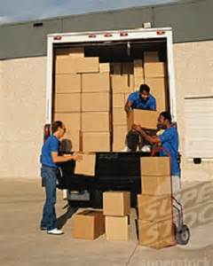
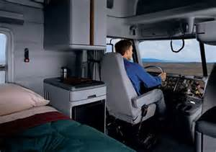
SAFETY-SENSITIVE FUNCTIONS
Driving or attending a commercial motor vehicle
Loading or unloading a CMV
Inspection, servicing, or repairing a CMV
Waiting to be dispatched or remaining in readiness to operate a CMV

Slide 16

WHO IS SUBJECT TO CONTROLLED SUBSTANCE & ALCHOL TESTING?
Drivers required to have a Commercial Driver’s License:
Interstate
Intrastate
For-Hire
Private

Slide 17
PRE-EMPLOYMENT TESTING
No employer shall allow a driver to perform safety-sensitive functions
UNLESS
The employer has RECEIVED a negative controlled substance test result

Slide 18
RANDOM TESTING
Owner-operators and carriers with one driver MUST join a consortium
Random Program Pools Must:
Use a scientifically valid method of selection
Ensure each driver has an equal chance of selection
Ensure random tests are unannounced
Spread tests reasonably throughout the year
Annual Testing Requirements:
Controlled Substances 25% (effective Jan. 1, 2016) Alcohol 10%

Slide 19
POST-ACCIDENT TESTING
Surviving drivers must be tested when:
Loss of human life is involved,
OR
The driver receives a citation
AND
There is a patient transported by ambulance
OR
A vehicle has disabling damage requiring towing from the scene
49 CFR Part 382.303(a) & (b)

Slide 20
ADMINISTRATION OF POST-ACCIDENT TESTS
Alcohol: Test within 2 hours
  Cease attempts to test after 8 hours
Controlled Substances: Test within 32 hours
  Cease attempts to test after 32 hours
Prepare and maintain reasons for not promptly administering tests, if applicable

Slide 21

REASONABLE SUSPICION TRAINING
Based on a TRAINED supervisor’s observations of
Appearance
Behavior
Speech
Body odors
Supervisor Training:
60 minutes on alcohol misuse, and
60 minutes on controlled substance use
*Not applicable to owner-operators in non-supervisory roles.

Slide 22
PART 382 .401– RETENTION OF DRUG AND ALCOHOL PROGRAM RECORDS:
Five Years:
Alcohol test results showing a concentration .02 or higher
Verified positive results of drug tests
Refusals to take drug or alcohol test (must be provided to future employers)
Driver evaluation and referrals
Records related to the administration of the program
Copy of each calendar year summary
A service agent (e.g., Consortia/Third party administrator) may prepare the MIS report on behalf of an employer. However, a company official must sign/certify the accuracy and completeness of the MIS report, no matter who prepares it.
Two Years
Records related to the alcohol and controlled substances collection process (except calibration of evidential breath testing devices) including:
Random selection process records;
Reasonable suspicion testing documentation;
Post accident testing documentation; and
Medical explanation for a driver’s inability to provide adequate sample.

Slide 23
PART 382 .401– RETENTION OF DRUG AND ALCOHOL PROGRAM RECORDS:
One Year
Records of negative and cancelled substances test results; and
Alcohol test results with a concentration of less than 0.02.
Indefinite Period
Records must be maintained by the employer while the individual performs the functions which require the training and for two years after ceasing to perform those functions.
All records related to the training and education of drivers, supervisors, breath alcohol technicians, and screening technicians;
Employer’s testing policy; and
Driver’s signed receipt for educational materials and policy received.

Slide 24

PROHIBITED CONDUCT
Drivers shall not perform safety-sensitive functions within 4 hours after using alcohol.
Drivers shall not possess alcohol in a vehicle at any time unless it is part of the load.
Drivers who use controlled substances shall not perform safety-sensitive functions.

Slide 25
POSITIVE DRIVER? -- WHAT NEXT?
Driver must be removed from all safety-sensitive functions immediately
Has to have a face-to-face evaluation by a Substance Abuse Professional (SAP)
Must have a “Return-to-Duty” test (observed)
Must have a minimum of 6 unannounced “Follow-Up” tests within 12 months
*You do not have a retain a positive driver, however, you must refer the driver to a SAP and maintain positive test records for 5 years.

Slide 26

EDUCATIONAL MATERIALS
Carriers must provide educational materials explaining the requirements of the regulations and the employer’s policy regarding alcohol misuse and controlled substance abuse.
Carrier must maintain original signed certificate of receipt of educational materials and policy for each driver.

Slide 27

DRUG & ALCOHOL PROGRAM RECORDS
Secure location
Controlled access
Records must be available for inspection within 48 hours when requested by FMCSA or certified agent
Maintain records for the minimum period of retention set forth in 49 CFR 382.401

Slide 28
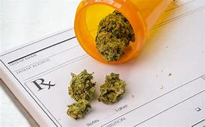
MEDICAL MARIJUANA
Medical marijuana is legal in the state of Florida, however, marijuana usage of any kind is still illegal by federal law.
Because the drug and alcohol testing requirements are set to a federal standard, drivers legally using medical marijuana in the state of Florida will fail a required drug test. Marijuana usage while operating a CMV is still prohibited.

Slide 29
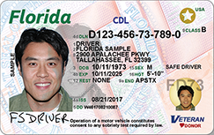
Commercial Driver Licenses
Florida Statute 322.54

Slide 30

DRIVERS MUST BE LICENSED FOR THE TYPE OF VEHICLE BEING OPERATED
Proper class
A, B, C
Proper Endorsements
HM, Tank, Doubles/Triples, Passenger
Observe Restrictions
Corrective lenses, hearing aid, air brakes, etc.
*Florida statutes state that the actual physical weight of the vehicle, in addition to GVWR, will be used in determining proper license class.

Slide 31
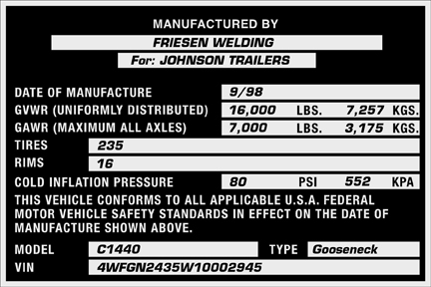
CDL REQUIREMENTS
Class A: Power unit and trailer with a combined GVWR over 26,000 pounds with a trailer GVWR over 10,000 pounds.
Class B: Power unit with a GVWR over 26,000 pounds (or also with a trailer GVWR of 10,000 pounds or less).
Class C: Placardable amount of hazardous materials or passenger vehicle used to transport 16 or more passengers, including the driver. *Class C CDLs are for vehicles in which a class A or B is not needed.

Slide 32
LEGISLATIVE REMINDERS
FSS 322.61 adds violations that will result in disqualification from operating a CMV after violating an Out-of-Service Order (1st Offense = 180 days; 2nd Offense = 2 years).
FSS 316.3025(3)(b)(1) adopts $100 penalty for each violation of the North American Uniform Driver Out-of-Service Criteria
FSS 316.3025(3)(b)(2) adopts $100 penalty for violations of the 12/16 and 70/80 hour rules (Intrastate hours of service).
FSS 316.3025(3)(b)(3) adopts $100 penalty for unauthorized passengers per 49 CFR 392.60
FSS 316.3025(3)(b)(5) adopts $100 penalty for not possessing a valid medical certification
FSS 316.159(3) states that all drivers of CMVs are required to slow before crossing railroad tracks.

Slide 33
FSS 316.3025 -- MOBILE PHONE & TEXTING BAN TO ALL CMVs
 |  |  | Penalties
Florida Statute | Federal Regulation | Violations | 1st Offense | 2nd Offense | 3rd Offense
316.3025(6)(a) | 49 CFR s. 392.82 | Using Handheld Mobile Telephone While Driving a CMV | $500 | $1000 | $2750
316.3025(6)(a) | 49 CFR s. 392.80 | Texting While Driving CMV | $500 | $1000 | $2750
316.3025(6)(b) | 49 CFR s. 392.82 | Company Allowing or Requiring Driver of CMV to Use Handheld Mobile Telephone While Driving | $2750 | $5000 | $11000
316.3025(6)(b) | 49 CFR s. 392.80 | Company Allowing or Requiring Driver of CMV to Text While Driving | $2750 | $5000 | $11000

Slide 34
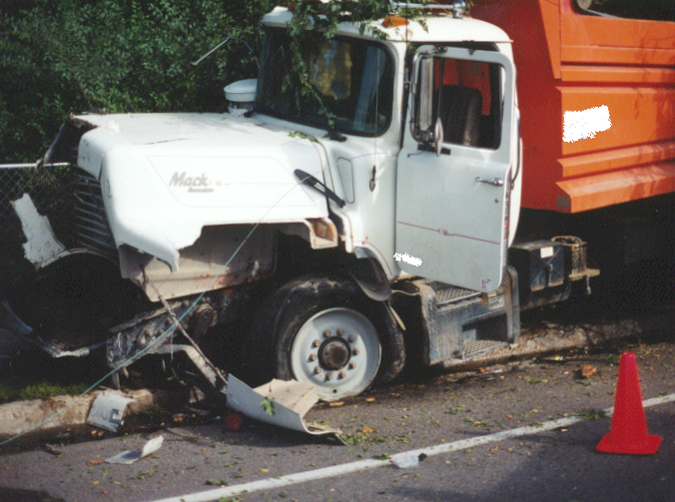
Commercial Motor Vehicle Insurance
Florida Statute 627.7415

Slide 35
Required Liability Coverage
GVW 26,000 – 34,999 lbs. - $ 50,000
GVW 35,000 – 43,999 lbs. - $100,000
GVW 44,000 lbs. or More - $300,000
Note:
49 C.F.R. Part 387 applies to certain for-hire and hazardous materials carriers.
Florida Statute 627.742 applies to non-public sector buses.

Slide 36
Accident Register -- 49 CFR 390.15
Date of Accident
City and State
Driver Name
Number of Injuries/Fatalities
Hazardous Materials Released
Copy of Accident Report
*Maintain information for 3 years

Slide 37
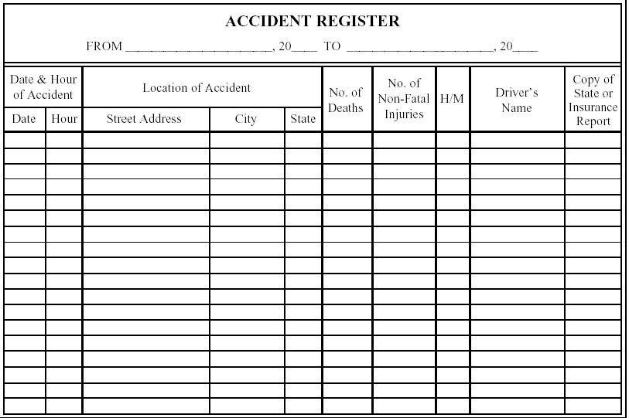

Slide 38
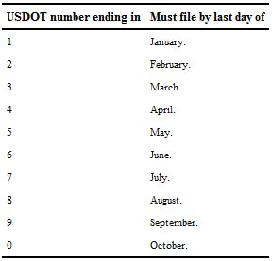
Biennial update of usdot #
49 CFR 390.19
File before beginning operations
  $500 Penalty for failure to register for a USDOT #
File an update within the first year of operations and then every 24 months -- or when vital company information changes.
Carriers can be penalized and have their USDOT # inactivated for failure to update.
If the next-to-last digit of its USDOT # is odd the motor carrier shall file its update every ODD-NUMBERED calendar year.
If the next-to-last digit of its USDOT # is even the motor carrier shall file its update every EVEN-NUMBERED calendar year.

Slide 39
Marking of Commercial Motor Vehicles
49 CFR 390.21
The name of the motor carrier and USDOT number
MUST be displayed:
Both sides of power unit
Sharply contrasting color
Legible from 50 feet
If name of any other person appears carrier name must be preceded by “operated by”
USDOT number must be preceded by the letters “USDOT”

Slide 40
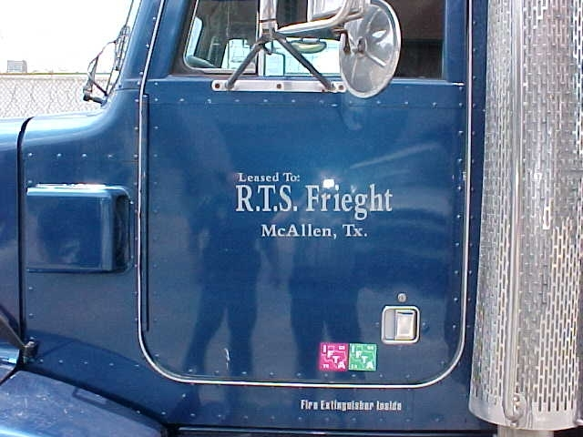
$50 PENALTY FOR IMPROPER MARKING

Slide 41
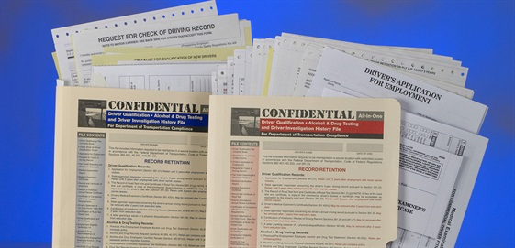
DRIVER QUALIFICATIONS
21 years of age (18 years of age for intrastate non-HM drivers)
Be able to safely operate the vehicle
Be physically qualified
Possess a valid/proper CDL

Slide 42
DRIVER DISQUALIFICATION
Loss of driving privileges
  Revocation, Suspension, Withdrawal
Criminal offenses
  DUI, Leaving the scene of an accident, Felony involving a CMV
Violations of Out-of-Service Orders
*Free Florida Dl check: https://services.flhsmv.gov/DLCheck/

Slide 43
DRIVER QUALIFICATION CHECKLIST
Driver’s application for employment
Inquiry to previous employers – 3 Years
DL inquiry to state agencies – 3 Years
Annual MVR inquiry to state agencies
Annual driver’s review & certification of violations
Driver’s road test certificate or equivalent
  Copy of CDL
Medical examiner’s certificate

Slide 44
EMPLOYMENT APPLICATION REQUIREMENTS
Signed by applicant
Contain name and address of employing motor carrier
Applicant’s name, address, DOB, SSN
Past 3 years residency from date of application
Date application is submitted
Issuing state, number and expiration date of each unexpired license
Nature and extent of applicant’s experience, including type of truck, bus, etc
List of all vehicle accidents during the 3 years preceding application date, specifying date, nature, and injuries or fatalities
List of all vehicle law violations (excluding parking) convicted of during the 3 years preceding application date

Slide 45
EMPLOYMENT APPLICATION REQUIREMENTS
A statement setting forth in detail the facts and circumstances of any denial, suspension, revocation, etc of their DL, or a statement that none have existed
List of names and addresses of employers for 3 years (10 years for CDL drivers) preceding application date, to include employment dates and reason for leaving (after 10-29-04, was the applicant subject to FMCSR’s and was alcohol and drug testing a requirement).
Certification and signature line/date must appear at the bottom of the application: “This certifies that the application was completed by me, and that all entries on it are true and complete to the best of my knowledge”

Slide 46
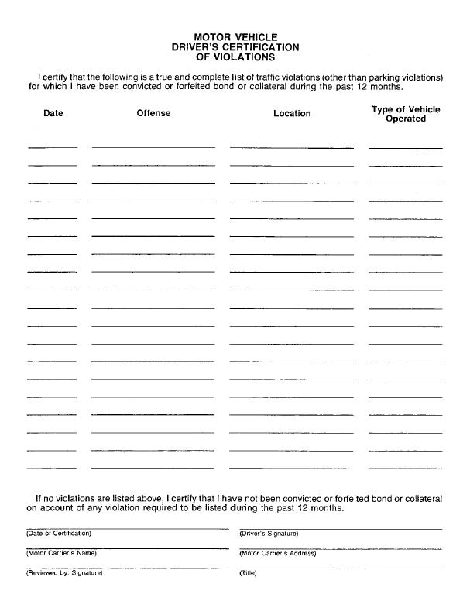
Driver must report all tickets to carrier within 30 days. Each non-parking violation must be recorded by driver.
Carrier is to acquire driver’s MVR each year and compare this list to the MVR and certify they’ve reviewed the MVR.
*This is to be completed after driver is employed more than 1 year.

Slide 47
MEDICAL EXAMINER’S CERTIFICATE
(MEDICAL CARDS)
Through 2021, all CDL holders must provide a copy of their medical card to the state that issues their CDL. This can be presented in person at the driver license office, or uploaded online.
Florida drivers may upload prior to the expiration date here: https://services.flhsmv.gov/CDLMedCert/
Expired medical cards must be taken in person.
A driver’s CDL will be disqualified and downgraded to a Class E if a new medical card is not provided within 20 days of expiration. During this time a carrier and driver can be cited. The driver will also have to pay a reinstatement fee.
The Florida exemption for insulin dependent diabetics was removed from Florida State Statute effective October 1, 2019.

Slide 48
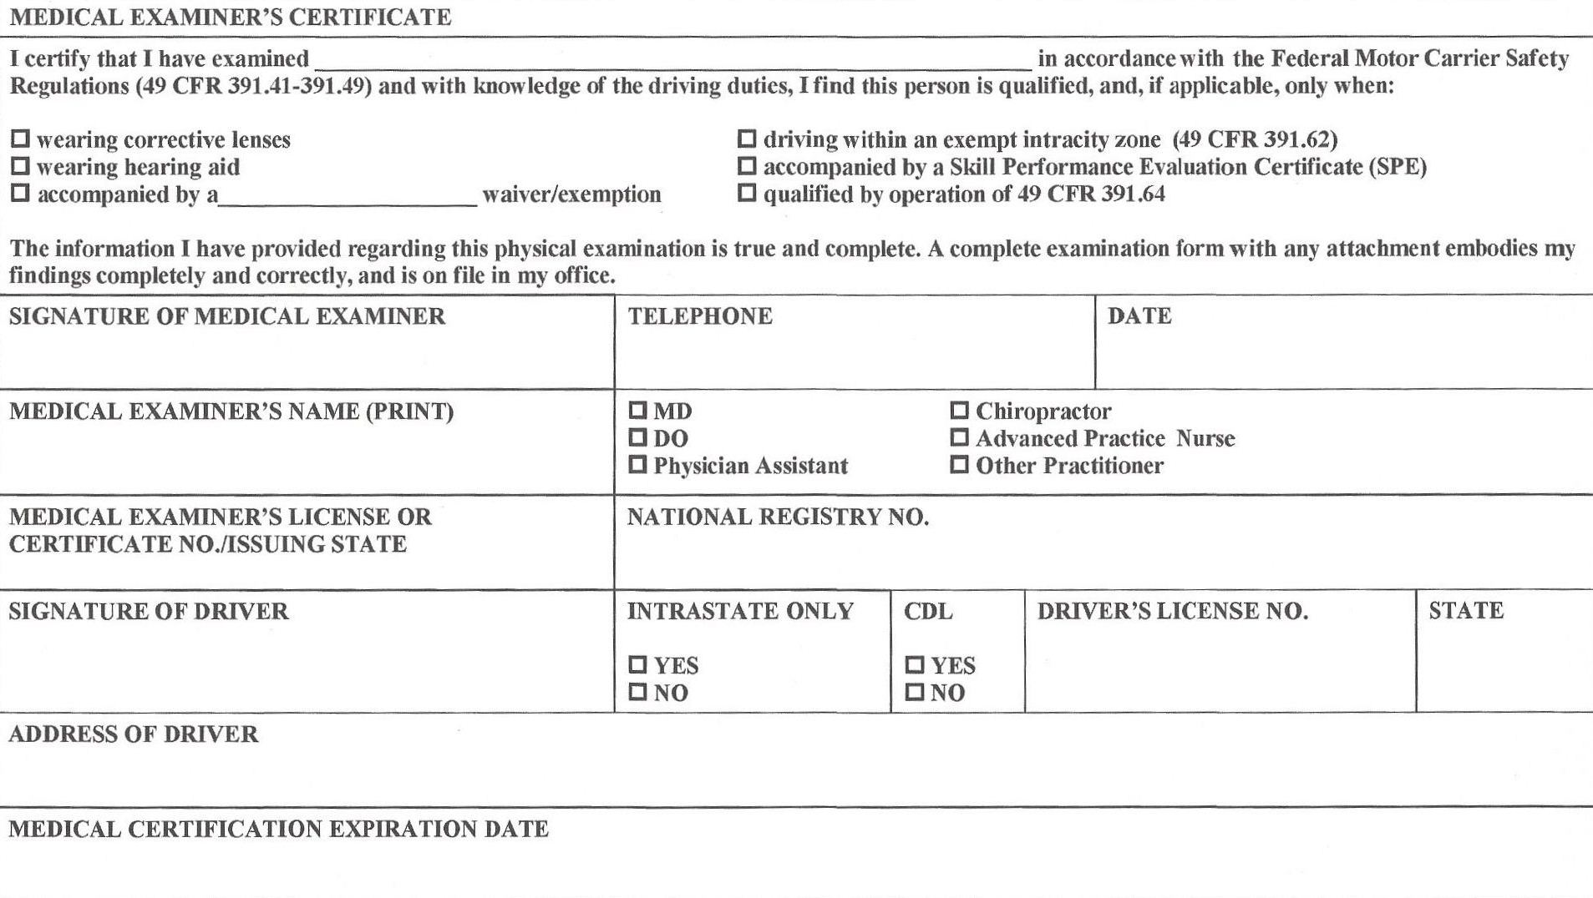
Effective May 21, 2014, anyone that provides a DOT medical examination must be registered in the FMCSA’s National Registry of Medical Examiners. If they are not, the card is not valid.
*New cards now have a field for the examiner’s National Registry Number that must be filled in.

Slide 49
DRIVER INVESTIGATION HISTORY FILE
49 CFR PART 391.23
Previous employer safety performance history inquiry to be conducted within 30 days of employment
Acquire employee’s written consent with application
Request positive or refused alcohol or controlled substance tests
Obtain information from previous FMCSA regulated employers for the past 3 years
Or documentation of “good faith” efforts to contact previous employer

Slide 50
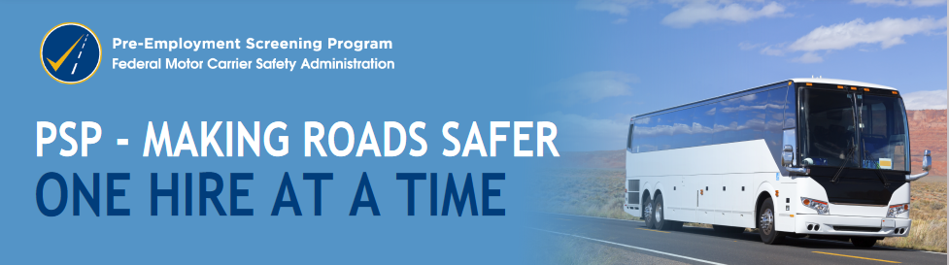
A PSP record contains a driver’s most recent 5 years of crash data and the most recent 3 years of roadside inspection data from the FMCSA MCMIS database.
Account holders may request PSP records solely for the purpose of conducting pre-employment screening and only with the driver's authorization.
FMCSA conducted a study to evaluate PSP's safety impact. The study results showed that companies regularly using PSP have, on average, reduced their crash rates by 8% and their driver Out-of-Service rates by 17%.
https://www.psp.fmcsa.dot.gov/psp/default.aspx

Slide 51
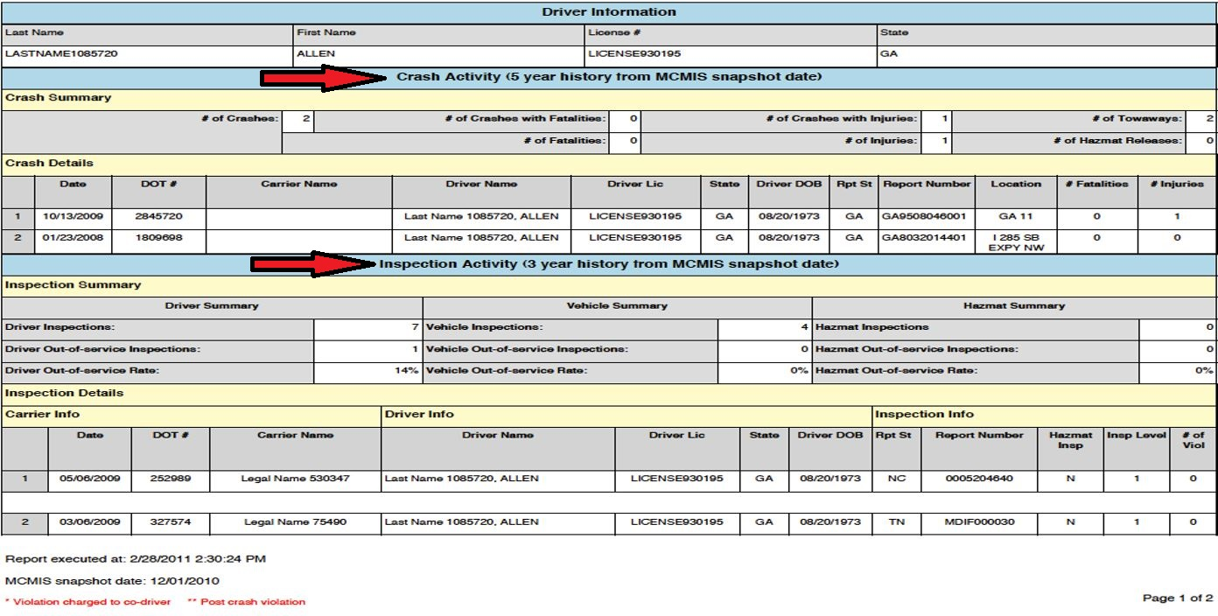

Slide 52
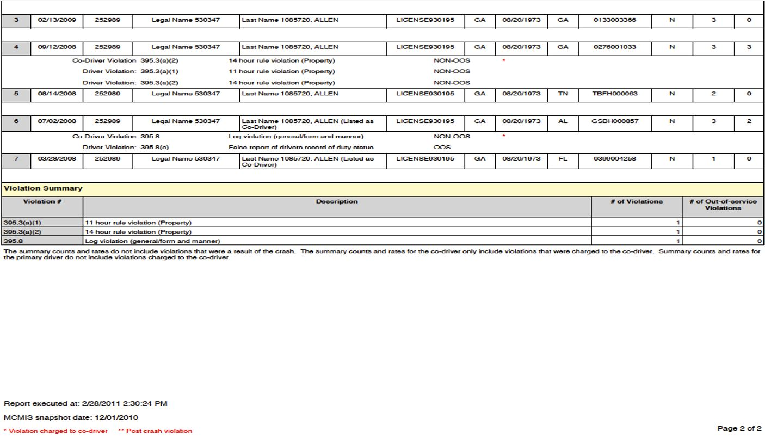

Slide 53
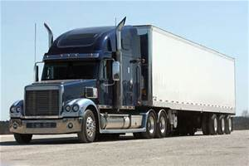
PART 392
DRIVING OF COMMERCIAL MOTOR VEHICLES

Slide 54
SCOPE OF THE RULES
Every employer and employee shall comply and be conversant with the requirements and specifications
No employer shall operate a commercial motor vehicle unless it is properly equipped
Every commercial motor vehicle must be operated in accordance with the laws, ordinances, and regulations of the jurisdiction in which it is being operated. However, if a regulation of the Federal Motor Carrier Safety Administration imposes a higher standard of care than that law, ordinance or regulation, the Federal Motor Carrier Safety Administration regulation must be complied with.

Slide 55
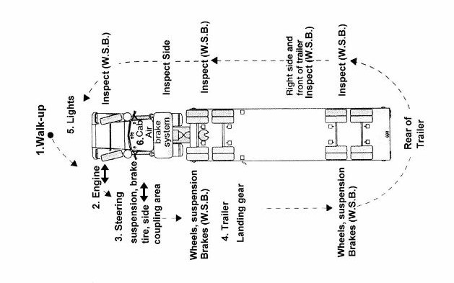
PART 393
PARTS AND ACCESSORIES FOR SAFE OPERATION

Slide 56
WHAT IS COVERED BY PART 393?
Lighting devices, reflectors, and tape
  Electrical equipment and wiring specifications
Brakes
  Parking brakes, trailer breakaway, and low air warning
Window construction and tint
  Allows 70% transmittance of light
Fuel systems
  Construction, location, and venting systems
Coupling devices and towing methods
  Fifth wheel, saddle mount, and safety devices

Slide 57
WHAT IS COVERED BY PART 393?
Miscellaneous parts and accessories
  Tires, speedometer, rear-end protection, and horn
Emergency equipment
  Fire extinguisher, triangles, and spare fuses
Protection against shifting and falling cargo
Frames, cab, and body components
  Wheels, rims, suspension systems, and steering systems

Slide 58
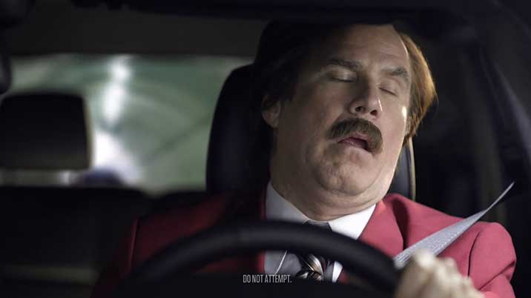
INTRASTATE DRIVERS’ HOURS OF SERVICE
(HOS)
1
2
3
4
5
6
7
8
9
10
11
NOON
11
Midnight
1
2
3
4
5
6
7
8
9
10
TOTAL HOURS
off duty
Sleeper
Berth
23
Driving
On Duty
not
driving

Slide 59
THREE CLASSIFICATIONS OF DRIVERS
Drivers operating solely in intrastate commerce not transporting hazardous materials
Drivers transporting hazardous materials
Drivers of non-public sector buses
*More than one classification may apply to your company/drivers depending on the work they perform

Slide 60
DRIVER’S HOS DEFINITIONS
  Air Mile: A “nautical mile” equivalent to 1.1508 statute miles
  100 air miles = 115.08 statute miles
  150 air miles = 172.62 statute miles
  Driving Time: All time spent at the driving controls of a CMV in operation
  On Duty: All time from the time a driver begins to work, or be in readiness to work, until the time the driver is relieved from work and all responsibilities for performing work.
  Calculator Example
  http://www.distancesfrom.com/Flight-Distance.aspx

Slide 61
INTRASTATE DRIVERS NOT TRANSPORTING HAZMAT OR PASSENGERS
Florida Statute 316.302(2)
  12 Hour Rule: May not drive more than 12 hours following 10 consecutive hours off duty
  16 Hour Rule: May not drive after the end of the 16th hour after coming on duty following 10 consecutive hours off duty
  30 Minute Break: Does not apply to intrastate carriers, with the exception of HazMat haulers. Florida Statute 316.302(2)(a), excepts intrastate carriers from 49 CFR Part 395.3(a) or (b), which outlines the rest break.

Slide 62
OPTIONS FOR OBTAINING A 10-HOUR REST PERIOD
  At least 10 consecutive hours off duty.
  At least 10 consecutive hours of sleeper berth time.
  At least 10 consecutive hours of combined off duty and sleeper berth time.
  At least 8 consecutive hours in a sleeper berth and a separate period of at least 2 consecutive hours either in the sleeper berth, off duty, or combination thereof.
  *Up to 2 hours riding in the passenger seat of a property-carrying CMV moving on the highway immediately before or after a period of at least 8 consecutive hours in the sleeper berth may be used to achieve a proper 10 hour rest period.

Slide 63
INTRASTATE DRIVERS NOT TRANSPORTING HAZMAT OR PASSENGERS
Florida Statute 316.302(2)
  70 Hour Rule: May not drive after having been on duty more than 70 hours in 7 consecutive days. (Motor carriers not operating every day of the week)
  80 Hour Rule: May not drive after having been on duty more than 80 hours in 8 consecutive days. (Motor carriers operating every day of the week)
  *Carrier must pick which rule applies to them and use one or the other.

Slide 64
INTRASTATE DRIVERS NOT TRANSPORTING HAZMAT OR PASSENGERS
Florida Statute 316.302(2)
34 consecutive hours off duty shall constitute the end of any 7 or 8 days period.
*Please note: Effective December 16, 2014 there are no longer limitations on when, or how many times, the 34 hour reset may be used.
Exceptions: Any period of 7 or 8 consecutive days may end with the beginning of any off duty period of 24 or more successive hours for:
  Ground water well drilling operations
  Construction materials
  Utility service vehicles
  See 49 CFR 395.1

Slide 65
INTRASTATE DRIVERS NOT TRANSPORTING HAZMAT OR PASSENGERS
Florida Statute 316.302(2)
Within a 150 air-mile radius: Retain time records for 6 months showing:
Time the driver reports for duty
Time the driver is released from duty
Total hours on duty
Preceding 7 days time for first time or intermittent drivers
A log book is required for any days that the driver is not released from duty within 12 hours beginning October 1, 2019.
Beyond a 150 air-mile radius: Maintain records of duty status (ELD/Log Book) in accordance with 49 CFR 395.8 or 395.22 for
6 months.

Slide 66
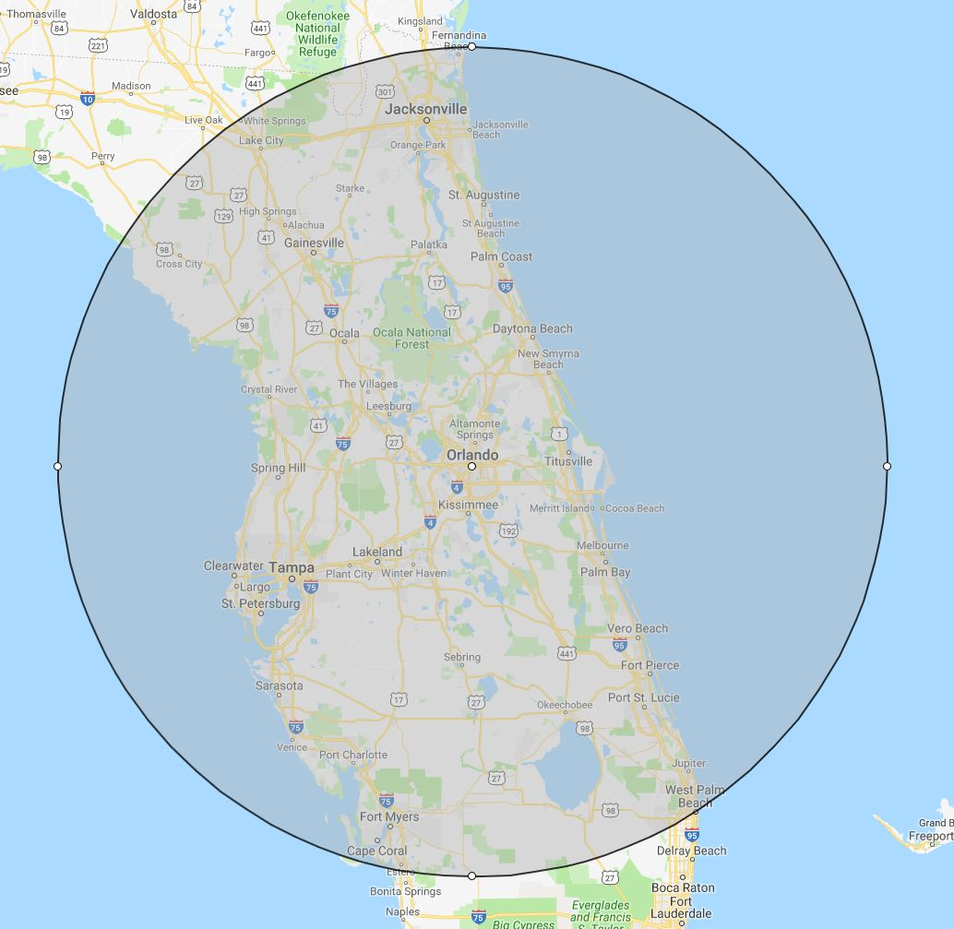
150-Air Mile Radius Explained
    The center dot is Orlando, FL and the circle depicts 150 miles in every direction.
    If the driver remains inside of the circle, only time records are required.
    If the driver travels outside of the circle, an ELD or Log Book is then required.

Slide 67


  The usage of Electronic Logging Devices (ELDs) has been mandated for carriers operating in interstate commerce beginning December 18, 2017.
  In June 2019, the state of Florida passed HB725 mandating the use of ELDs for carriers operating in intrastate commerce. Beginning January 1, 2020 all intrastate carriers requiring a logbook will be required an ELD in accordance with CFR 395.20 – 395.38. Exceptions can be found in 49 CFR 395.8(a)(1)(iii).
  ELDs used by carriers operating in intrastate commerce must conform to the rules and regulations set for by CFR 395.20 - 395.38
  Registered ELDs: https://eld.fmcsa.dot.gov/List

Slide 68

  ELD Exemptions
  Drivers who use the short-haul, timecard exceptions are not required to keep records of duty status (RODS) or use ELDs
  Drivers who are required to keep RODS not more than 8 days within any 30-day period.
  Drivers conducting a drive-away-tow-away operation, (an operation in which an empty or unladen motor vehicle with one or more sets of wheels on the surface of the roadway is being transported).
  Drivers of vehicles manufactured before the model year 2000.

Slide 69
DRIVERS TRANSPORTING HAZMAT
CFR 395.3
  11 Hour Rule: May not drive more than 11 hours following 10 consecutive hours off duty
  14 Hour Rule: May not drive after the end of the 14th hour after coming on duty following 10 consecutive hours off duty
  60 Hour Rule: May not drive after having been on duty more than 60 hours in 7 consecutive days. (Motor carriers not operating every day of the week)
  70 Hour Rule: May not drive after having been on duty more than 70 hours in 8 consecutive days. (Motor carriers operating every day of the week)
  30 Minute Break: Must not drive if more than 8 hours have passed since the last off duty, or sleeper berth, period of at least 30 minutes (8 hours includes on duty time)

Slide 70
DRIVERS TRANSPORTING HAZMAT
49 CFR 395.3
34 consecutive hours off duty shall constitute the end of any 7 or 8 days period.
Exceptions: Any period of 7 or 8 consecutive days may end with the beginning of any off duty period of 24 or more successive hours for:
  Ground water well drilling operations
  Utility service vehicles
  See 49 CFR 395.1

Slide 71
DRIVERS TRANSPORTING HAZMAT
CFR 395.3
  100 air-mile radius drivers are exempt from 49 CFR 395.9 (ELD/Log Book) if:
  The driver returns and is released from work within 12 consecutive hours
  The driver has at least 10 consecutive hours off duty separating each 12 hours on duty
  The motor carrier retains time records for 6 months showing
    Time the driver reports for duty
    Time the driver is released from duty
    Total hours on duty
    Preceding 7 days time for first time or intermittent drivers

Slide 72
DRIVERS OF NON-PUBLIC SECTOR BUSES
49 CFR 395.5
  10 Hour Rule: May not drive more than 10 hours following 8 consecutive hours off duty
  15 Hour Rule: May not drive after the end of the 15th hour after coming on duty following 8 consecutive hours off duty
  60 Hour Rule: May not drive after having been on duty more than 60 hours in 7 consecutive days. (Motor carriers not operating every day of the week)
  70 Hour Rule: May not drive after having been on duty more than 70 hours in 8 consecutive days. (Motor carriers operating every day of the week)
  *Passenger carriers can not use the sleeper berth provision (split sleeper) to achieve a proper 8 hour off duty period

Slide 73
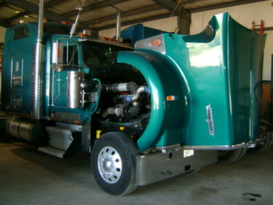
PART 396
INSPECTION REPAIR AND MAINTENANCE

Slide 74
VEHICLES MAINTENANCE FILES
CFR 396.3
  Applies to:
    Vehicles with a GVWR of 10,001 pounds or more
    Designed to transport more than 10 passengers (including driver) for compensation
    Vehicles transporting hazardous materials
  Required records:
    Identification of the vehicle (Make, Model, VIN, and Tire Size)
    Nature and due date of inspection/maintenance
    Record of inspection, repair, and maintenance
  Record retention:
    Retain records where the vehicle is housed or maintained for 1 year. Retain records for 6 months after the vehicle leaves your control.

Slide 75
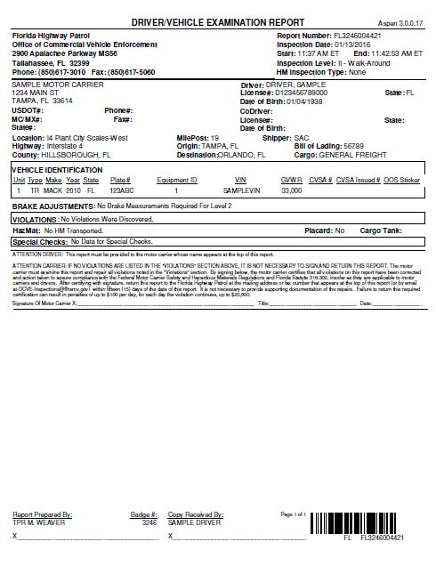
DRIVER VEHICLE EXAMINATION REPORTS (DVERs) -- CFR 396.3
    Correct ALL Out-of-Service violations prior to operation
    Correct all other violations prior to re-dispatch
    Certify and return the inspections with vehicle violations to the issuing agency within 15 days. *DVERs with no violations discovered do not need to be returned.
    Copies of DVERs must be maintained at the principle place of business for 12 months

Slide 76
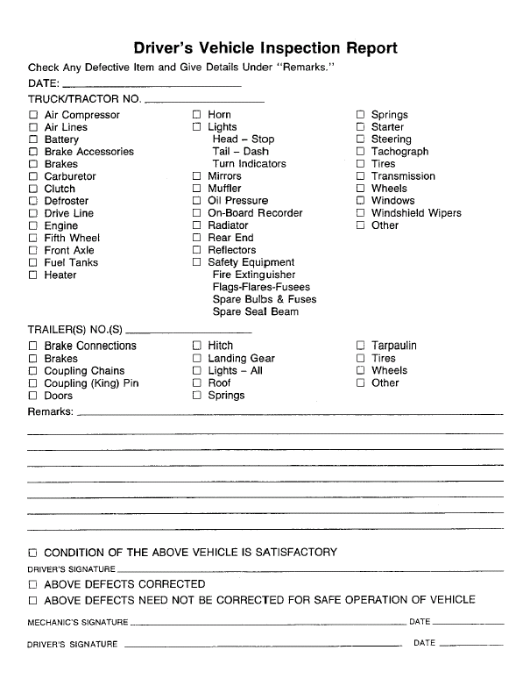
Driver Vehicle Inspection Reports (DVIR) -- 49 CFR 396.11
(Post-Trip Inspections)
Effective December 2014, Drivers of PROPERTY carrying vehicles are only required to complete a post-trip inspection report if a defect exists.
PASSENGER carriers must still complete post-trip inspection reports daily regardless of whether or not a defect exists.
Certify corrective action
Maintain for 3 months
Carriers with one truck are exempt as they were prior to the rule change.

Slide 77
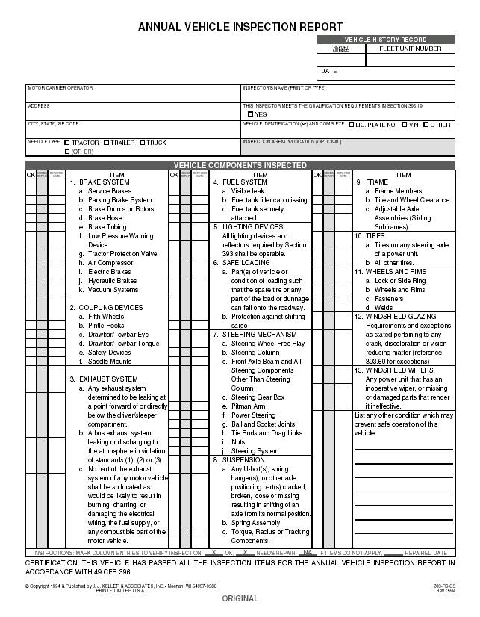
Periodic Inspections -- 49 CFR 396.17-25
Inspect vehicles at least once every 12 months
Prepare a report identifying the following
  Individual performing inspection
  Motor carrier assigned to vehicle
  Date of inspection
  Vehicle inspected
  Components inspected and results
Retain inspection reports for 14 months (current and one past)
Level 1 roadside inspection (DVER) with no vehicle violations NO LONGER suffice for compliance.

Slide 78
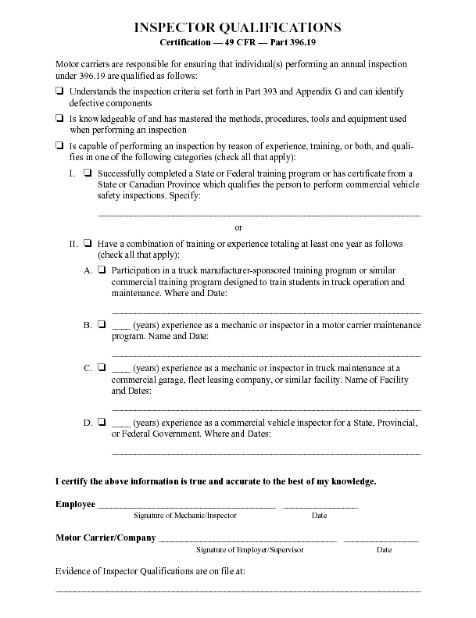
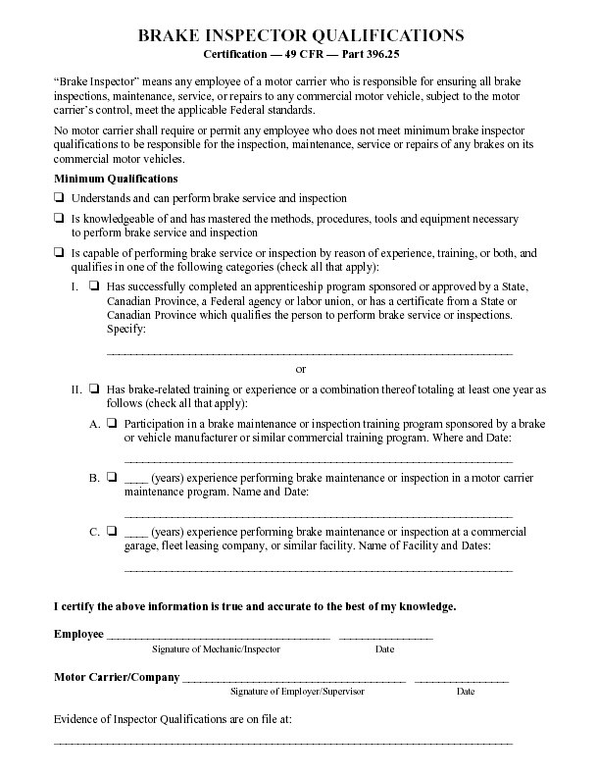
These forms must be kept on file for any inspector completing periodic or brake inspections.
Inspector Qualification Forms

Slide 79
RECORD RETENTION
Driver Files: As long as driver is employed and for three years thereafter, save current medical card and one past medical card
Vehicle Files: 1 year while vehicle is in fleet; 6 months after vehicle leaves carrier’s control
Annual Inspections: 14 months
Accident Register: 3 years
Time Records: 6 months
Daily Driver Vehicle Inspections (DVIR): 90 Days
Roadside Inspections (DVER): 1 Year

Slide 80
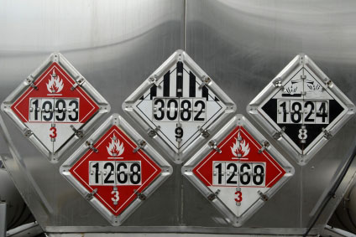
PART 397
TRANSPORTATION OF HAZARDOUS MATERIALS

Slide 81



Domestic Security
Motor carriers involved in transportation of hazardous materials must:
Develop and implement a security plan
Train employees to recognize and react to potential security threats
FHP’s Office of Commercial Vehicle Enforcement conducts on site security contact reviews and corporate security reviews.

Slide 82

Record maintenance
Maintain shipping papers/manifests for 2 years
Maintain hazardous waste manifests for 3 years
Keep PHMSA/Federal HazMat Registration Current
Maintain security plans
Document driver’s HazMat training
Document all employee’s HazMat training

Slide 83
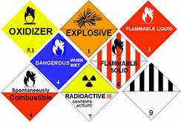
Driving and Parking Rules
Attendance
Parking
Smoking
Fueling
Routing
Railroad Crossings

Slide 84
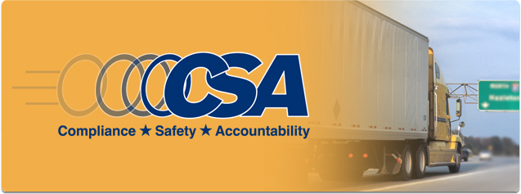
What is CSA?
CSA is a FMCSA initiative to improve large truck and bus safety and ultimately reduce crashes, injuries, and fatalities that are related to commercial motor vehicles. It introduces a new enforcement and compliance model that allows FMCSA and its State Partners to contact a larger number of carriers earlier in order to address safety problems before crashes occur.
https://ai.fmcsa.dot.gov/SMS/Default.aspx

Slide 85
The Safety Measurement System (SMS)
  FMCSA’s workload prioritization tool that identifies carriers for interventions (e.g., warning letters, investigations)
Safety Interventions Process
  Creates new and more efficient ways for FMCSA to interact with carriers and help bring them into compliance (e.g., warning letters and Onsite Focused Investigations)
Proposed Safety Fitness Determination (SFD)
  To assess safety performance of larger segment of industry, keeping more unsafe carriers off the road (still needs to go through a rulemaking process)

Slide 86
Prioritizes and identifies carriers for interventions (e.g., warning letters, investigations) using:
  State-reported crash records
  All roadside inspection safety-based violations
  Certain violations found during inspections
  Serious Violations found during investigations
Updates results once per month based on the prior 24 months of data (weighted based on severity and when events occurred)

Slide 87
Carriers are assigned a measure and percentile in each BASIC:
  Measure reflects your own company’s safety performance (SMS converts BASIC data (e.g., inspections) into a quantifiable measure)
  Percentile rank reflects your on-road safety performance compared to other carriers with similar fleet size and safety events
BASICs prioritized may trigger an intervention
Monitor your BASICs and take immediate action

Slide 88
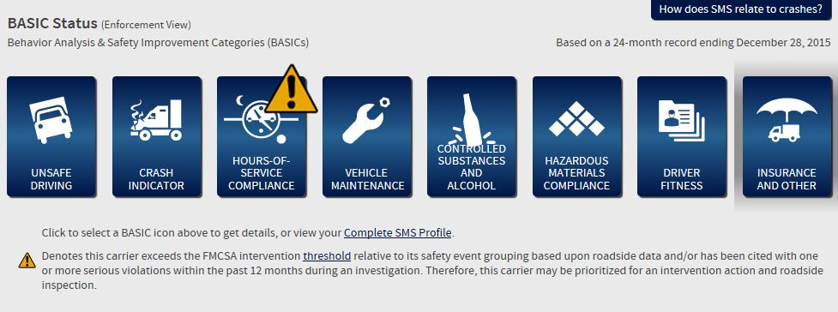
There are 7 different Behavior Analysis & Safety Improvement Categories (BASICs) used to rate carriers.
*Alerts will show with a yellow triangle and exclamation point.

Slide 89
INTERVENTION THRESHOLDS
PROPERTY
UNSAFE DRIVING = 65%
CRASH INDICATOR = 65%
HOURS OF SERVICE = 65%
VEHICLE MAINTENANCE = 80%
CONTROLLED SUBSTANCES/ALCOHOL = 80%
HAZARDOUS MATERIALS = 80%
DRIVER FITNESS = 80%

Slide 90
INTERVENTION THRESHOLDS
PASSENGER
UNSAFE DRIVING = 50%
CRASH INDICATOR = 50%
HOURS OF SERVICE = 50%
VEHICLE MAINTENANCE = 65%
CONTROLLED SUBSTANCES/ALCOHOL = 65%
HAZARDOUS MATERIALS = 80%
DRIVER FITNESS = 65%

Slide 91
WHY ARE MOTOR CARRIERS SELECTED FOR COMPLIANCE INVESTIGATIONS?
Crashes and HazMat incidents
BASIC Alerts -- especially two or more alerts for two or more consecutive months
Substantiated complaints
Security contact reviews (HazMat carriers)

Slide 92
PURPOSE OF
COMPLIANCE INVESTIGATIONS
To assess existing safety management controls
To provide educational and technical assistance
To reduce the risk of motor vehicle crashes

Slide 93
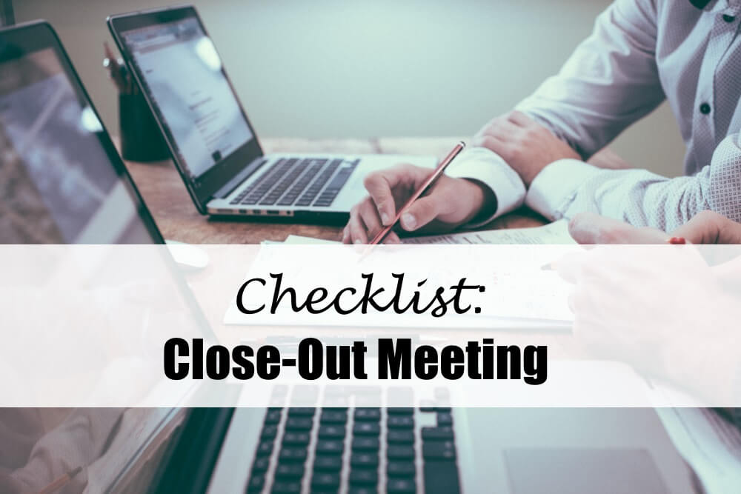
COMPLIANCE INVESTIGATION CLOSE OUT
The Trooper will explain the findings of the review and discuss any suggestions for improving your safety program.

Slide 94
VIOLATIONS MAY RESULT IN PENALTIES
First compliance investigation
  May result in penalties up to $5,000
Follow-up compliance investigation
  May result in penalties up to $25,000
Second follow-up (and subsequent) compliance investigations
  May result in penalties up to $25,000 and enjoinment (Out-of-Service order)

Slide 95
ETA = Educational & Technical Assistance
This online guide provides simple explanations and templates to help carriers understand and comply with Federal Motor Carrier Safety Regulations -- including a forms library.
https://csa.fmcsa.dot.gov/safetyplanner/

Slide 96
RELATED WEBSITES:
Florida Department of Highway Safety and Motor Vehicles’ Bureau of Commercial Vehicle Enforcement
https://www.flhsmv.gov/florida-highway-patrol/specialized-areas/commercial-vehicle-enforcement
United States Department of Transportation Federal Motor Carrier Safety Administration
http://www.fmsca.dot.gov
Florida State Statutes On-Line
http://www.flsenate.gov/Laws/Statutes
USDOT Transportation Safety Institute Courses on HazMat, Interstate operations, etc.
http://www.tsi.dot.gov

Slide 97
FLORIDA HIGHWAY PATROL
OFFICE OF COMMERCIAL VEHICLE ENFORCEMENT
Compliance Investigation Coordinator
Captain Charles Smalley 850-617-2284
Compliance Investigation Lieutenant
Lieutenant Michael Weaver 352-326-7776
Email Questions to:
newentrant@flhsmv.gov

Slide 98

THANK YOU FOR YOUR ATTENTION AND SAFE OPERATIONS!

