Slide 1
Commercial Motor Vehicle Crash Record Reporting

Slide 2
Commercial Motor Vehicle Crash Record Reporting
2

Slide 3
3

Slide 4
4
4

Slide 5
5

Slide 6
6
6

Slide 7
Course Resources
Please click on each of the following resources and either download and save the documents to a file on your desktop or bookmark the link to the documents. You will find each of these documents useful when going through this course.
Instructions for Completing the Florida Uniform Crash Report Forms – HSMV 90010S
HSMV 90010S – Event Form
HSMV 90010S – Vehicle/Person Form
HSMV 90010S – Narrative/Diagram Form

Slide 8
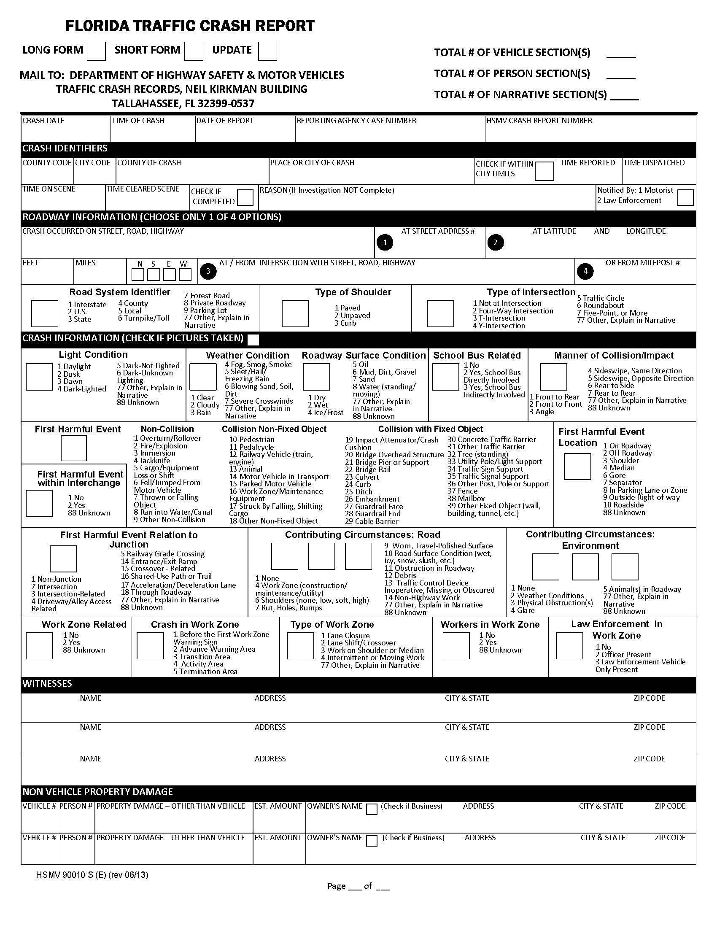
Completing the Florida Uniform Crash Report
(HSMV 90010S)

Slide 9
HSMV 90010S
The Florida Traffic Crash Report is used by law enforcement officers in Florida to report traffic crashes to the Department of Highway Safety and Motor Vehicles.
Traffic crashes can be reported by the use of Florida Traffic Crash Report and designated as either the “Long Form” or “Short Form.”

Slide 10
HSMV 90010S
A Long Form Report (HSMV 90010S) in its entirety must include a Narrative, Diagram when the following criteria are met:
Resulted in death of, personal injury to, or any indication of complaints of pain or discomfort by any of the parties or passengers involved in the crash;
Leaving the scene involving damage to attended vehicles or property (F.S. 316.061 (1));
Driving while under the influence (F.S. 316.193);
Rendered a vehicle inoperable to a degree that required a wrecker to remove it from the scene of the crash; or
Involved a commercial motor vehicle.

Slide 11
HSMV 90010S
The Short Form Report designation is used to report other types of traffic crashes. If form HSMV 90010S is used as a Short Form Report, a diagram and narrative are not required, otherwise a Long and Short Form Report have the same requirements.
Short Form Reports, as of July 1, 2012, must be submitted to the Department.
The investigating agency may retain a copy.

Slide 12
HSMV 90010S
The Florida Traffic Crash Reports are completed by filling in the blanks with required information obtained from an investigation of the event.
In some cases, the report displays a list of values for certain data that pertains to vehicles, drivers, non-motorists, passengers, and the scene of the traffic crash.
The investigating officer is required to select and enter a value in the appropriate data field. Some data fields are constructed to accept more than one value if warranted. The values needed to complete the event, vehicle, or person sections are displayed next to the data fields.

Slide 13
HSMV 90010S
All Long Form and Short Form crash reports must include:
The date, time, and location of the crash
Description of vehicle(s) involved
Names and address’ of all parties involved, including drivers and passengers
Names and address’ of all witnesses
The name, badge number and agency of the officer investigating the crash
Names of insurance companies

Slide 14
Event Page
This section is designed to identify overall characteristics of the traffic crash.

Slide 15
Crash Date
Time of Crash
Date of Report
County Code
City Code
County of Crash
Road System Identifier
Type of Shoulder
Type of Intersection
Light Condition
Weather Condition
Roadway Surface Condition
Manner of Collision/Impact
First Harmful Event
Contributing Circumstances
Work Zone Related
Type of Work Zone
Law Enforcement in Work Zone
School Bus Related
Total # of Vehicle Sections
Total # of Person Sections
Total # of Narrative Sections
Event Page
When completing a Short Form, a Narrative/Diagram Form must be completed if ‘77: Other-Explain in Narrative’ is selected.
Examples include:
Type of Intersection
Light Condition
Weather Condition
Roadway Surface Condition
Manner of Collision/Impact

Slide 16
Event Page
When ‘Work Zone Related’ is 2 - ‘Yes,’ the following fields are required:
Crash in Work Zone
Type of Work Zone
Workers in Work Zone
Law Enforcement in Work Zone
Note: If Work Zone Related is ‘1: No’ or ’88: Unknown’ leave other fields blank.

Slide 17
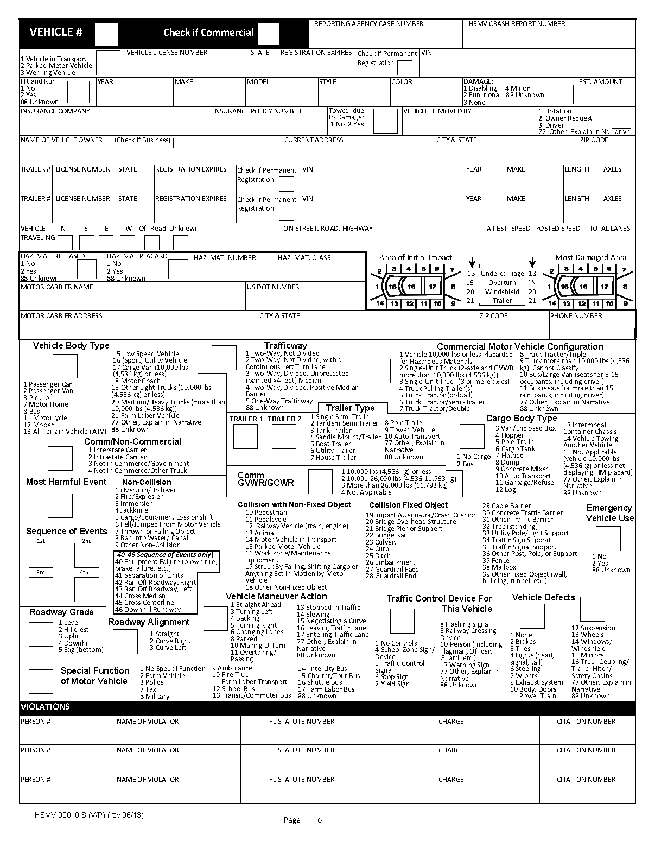
Vehicle Page
This section is designed to identify vehicle information.
The vehicle data elements are used to describe the characteristics, events and consequences of the motor vehicles involved in the traffic crash.
The violating vehicle is entered as vehicle number 1.

Slide 18
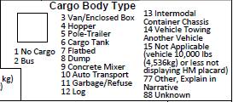
Check if Commercial
Insurance Company
Vehicle Travelling
Vehicle Body Type
Trafficway
Commercial Motor Vehicle Configuration
Comm/Non-Commercial
Most Harmful Event
Comm GVWR/GCWR
Cargo Body Type
Vehicle Maneuver Action
Vehicle Defects
Trailer Type
Roadway Grade
Roadway Alignment
Special Function of Motor Vehicle
Emergency Vehicle Use
Make
Model
Style
Vehicle Page
X
If ‘Check if Commercial’ is populated, the following fields are required:
Commercial Motor Vehicle Configuration
Cargo Body Type
Commercial GVWR/GCWR

Slide 19
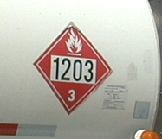
Vehicle Page
2
2
1203
3
If field ‘Haz-Mat Placard’ is populated with a 2 (Yes), then the following fields are required:
Haz-Mat Number
Haz-Mat Class

Slide 20
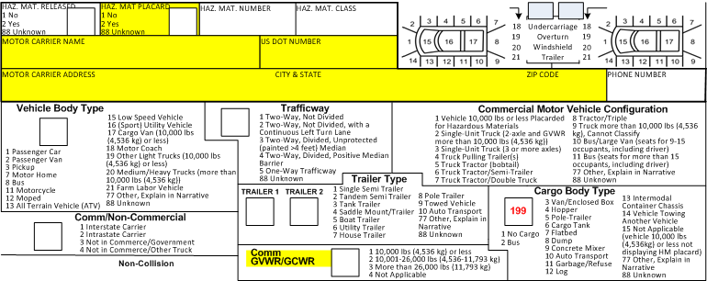
Vehicle Page
X
2
If ‘Comm GVWR/GCWR’ is populated with a 1, 2, or 3, the following fields are required:
Check if Commercial
Haz-Mat Placard
Motor Carrier Name
US DOT Number
Motor Carrier Address, City, State and Zip Code

Slide 21
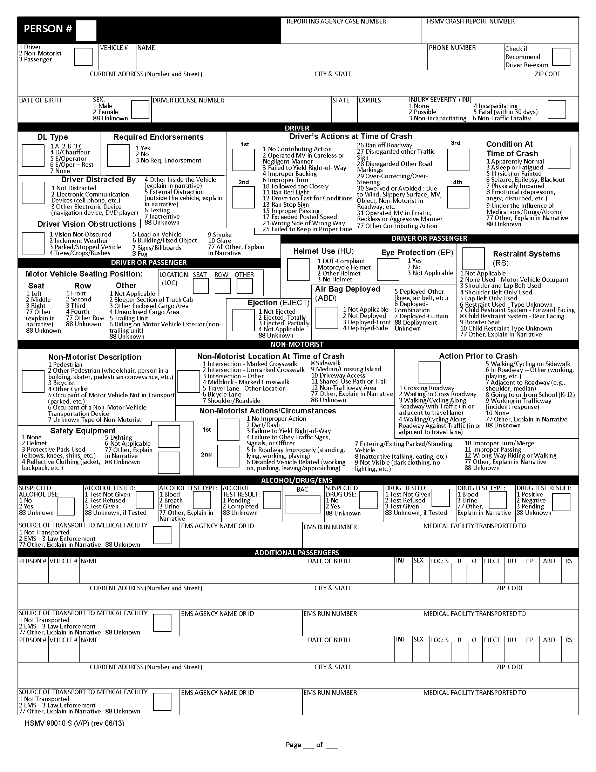
Person Page
The person data elements describe the characteristics, actions, and consequences to the person(s) involved in the crash.
Each person involved in the crash must be given a unique number.

Slide 22
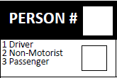
Person Page
Driver/Non-Motorist/Passenger
Driver’s Actions at Time of Crash
Condition at Time of Crash
Non-Motorist Description
Safety Equipment
Action Prior to Crash
Driver Distracted By
Motor Vehicle Seating Position
Driver License Number
DL Type
Air Bag Deployed
Restraint Systems
Suspected Alcohol Use
BAC
Suspected Drug Use
Source of Transport to Medical Facility
For the field ‘Driver/Non-Motorist/Passenger’ there is no longer an option of entering ‘88: Unknown.’
Either ‘1:Driver’, ‘2:Non-Motorist’, or ‘3:Passenger’ must be entered.
If ‘1: Driver’ is chosen, all of the Driver fields are required
If ‘2: Non-Motorist’ is chosen, all of the Non-Motorist fields are required
If Driver unknown due to ejection, list all parties as Passengers until Driver is determined

Slide 23
Person Page
DL Type
Driver required fields:
DL Type (enter a #, not a letter)
Driver Distracted By
Required Endorsements
1=Yes (Endorsement is required for DL)
2=No (DL lacks required endorsement)
3=No Required Endorsement (No Endorsement is required for DL)
Driver Vision Obstructions
Driver’s Actions at Time of Crash: A first occurrence is required, additional actions are optional.
Condition at Time of Crash

Slide 24
Person Page
Non-Motorist required fields:
Non-Motorist Description
Non-Motorist Location at Time of Crash
Action Prior to Crash
Safety Equipment
Non-Motorist Actions/Circumstances: A first occurrence is required, additional actions are optional.

Slide 25
Person Page
Suspected Alcohol Use
If ‘1: No’ is selected, all other alcohol related fields are NOT required.
Alcohol Tested
If ‘3: Test Given’ is selected, the field ‘Alcohol Test Type’ is required.
Alcohol Test Result
If ‘2: Completed’ is selected, the ‘BAC’ field is required.
Suspected Drug Use
If ‘2: Yes’ is selected, fields ‘Drug Tested,’ ‘Drug Test Type,’ and ‘Drug Test Results’ are required.

Slide 26
Person Page
Source of Transport to Medical Facility
If ‘2: EMS’ is selected, complete the following fields:
‘EMS Agency Name or ID’
‘EMS Run Number’
‘Medical Facility Transported To’

Slide 27
Person Page
If ‘Seat’ is populated, the field ‘Row’ must also be populated.
# | Seat (S) | Row (R) | Other (O)
1 | Left | Front | NA
2 | Middle | Second | Sleeper/Truck Cab
3 | Right | Third | Other Enclosed Cargo Area
4 | -- | Fourth | Unenclosed Cargo Area
5 | -- | -- | Trailing Unit
6 | -- | -- | Riding on MV Exterior
77 | Other | Other | --
88 | Unknown | Unknown | Unknown

Slide 28
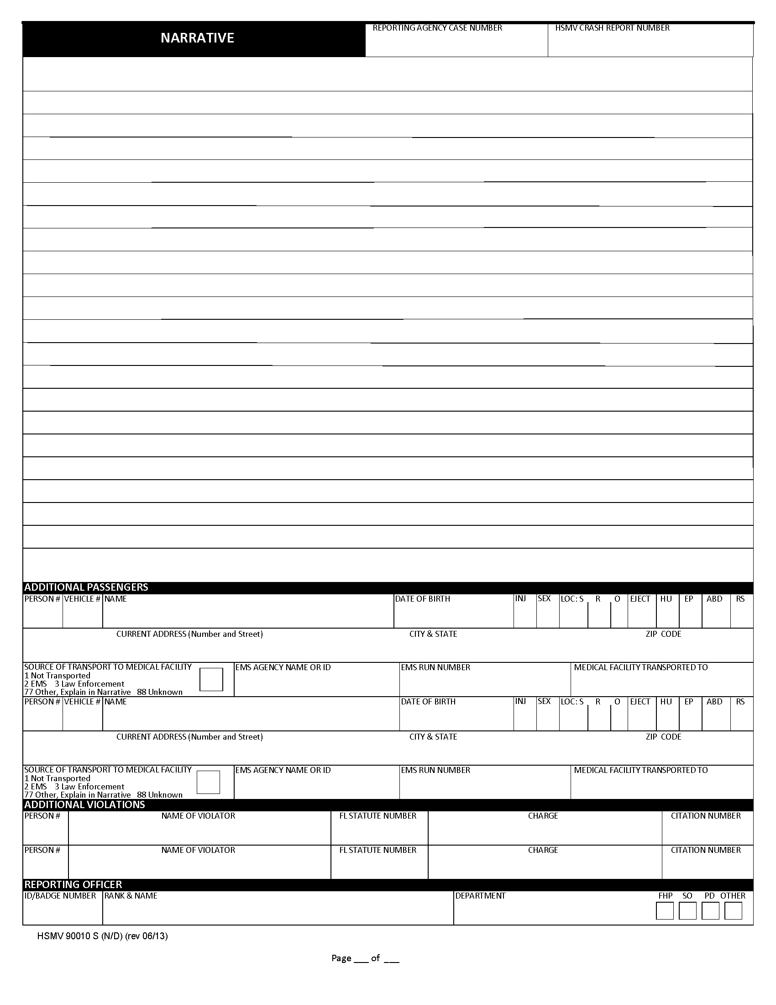
Narrative/Diagram
This report is used to describe the traffic crash scene. It is always used in conjunction with the Florida Traffic Crash Report, Long Form, HSMV 90010S.
The investigating agency report number and the eight digit HSMV crash report number must be identical to all other report pages.

Slide 29
Narrative
Describe what happened prior to, at, and post collision for each vehicle, drivers and non-motorist in a chronological sequence of events. Ensure that the correct section number is used when referring to specific vehicles, drivers or non-motorist. If additional space is needed use an additional narrative page.

Slide 30
Diagram
This space is used to draw the traffic crash scene. The diagram should be prepared based on the standard operating procedures of the submitting agency. However, at a minimum, the following information must be documented:
Location of traffic crash (road names).
Roadway markings.
North directional arrow being placed upward or to the right when looking at the page.
Any physical evidence on the roadway (skid marks, ruts, holes, standing water, etc.).
Each vehicle’s position prior to, at, and post crash. This would include where the vehicle was located at final rest upon the officer’s arrival on the scene even if the vehicle was moved.

Slide 31
Completing an Update of a Florida Uniform Crash Report
(HSMV 90010S)

Slide 32
Updates
x
This report is used to update or upgrade information previously recorded on a Florida Traffic Crash Report. When completing an update:
Code entries must correspond to the vehicle, driver or non-motorist section they are intended to represent.
When completing an update, select ‘Update’ only. ‘Long Form’ or ‘Short Form’ should NOT be selected.

Slide 33
Updates: Event Page
x
1
2
3
4
5
6
Required information:
Crash Date
Date of Report: Date of Update
Reporting Agency Case Number
HSMV Crash Report Number: Must use original crash report number (This field cannot be updated on crash report-contact courtassist@flhsmv.gov)
County Code: Appendix C
County of Crash: Appendix C

Slide 34
Updates: Person/Vehicle
Enter the vehicle or person information that is being updated.
Any information that is NOT being updated should be left blank.

Slide 35
Case Example
A long form has been submitted to the Department of Highway Safety and an update of the following information is needed:
Injury Severity: Changed Injury Severity Code from 4 to 5
BAC: Add BAC

Slide 36
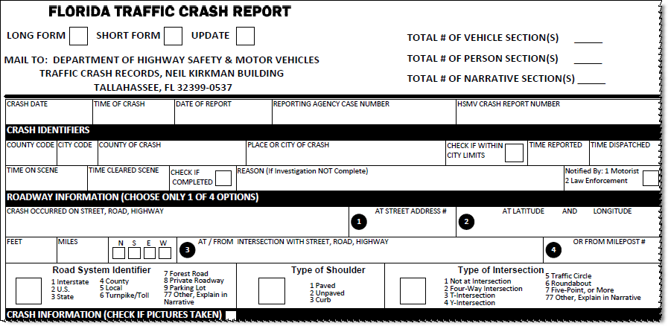
Updates: Case Example – Event Page
Original
Xx
1
2
2
12/11/2013
14:45
12/11/2013
123456
4596873
01
13
Miami-Dade
14:49
14:51
14:56
16:46
2
Hill Top Road
1400
Intersection of Hill Top and Meridian Road
5
1
2
Update
Xx
1
1
12/11/2013
14:45
1/10/2014
123456
4596873
01
Miami-Dade
2

Slide 37
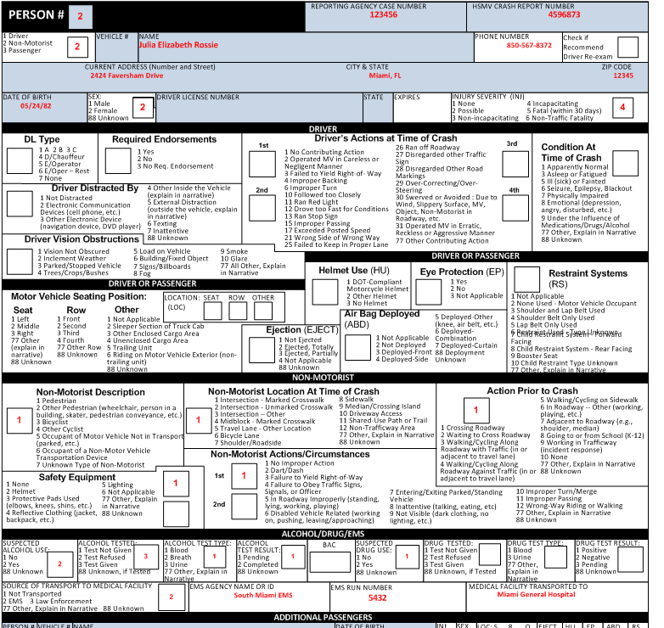
Updates: Case Example - Person
Original
1

Slide 38
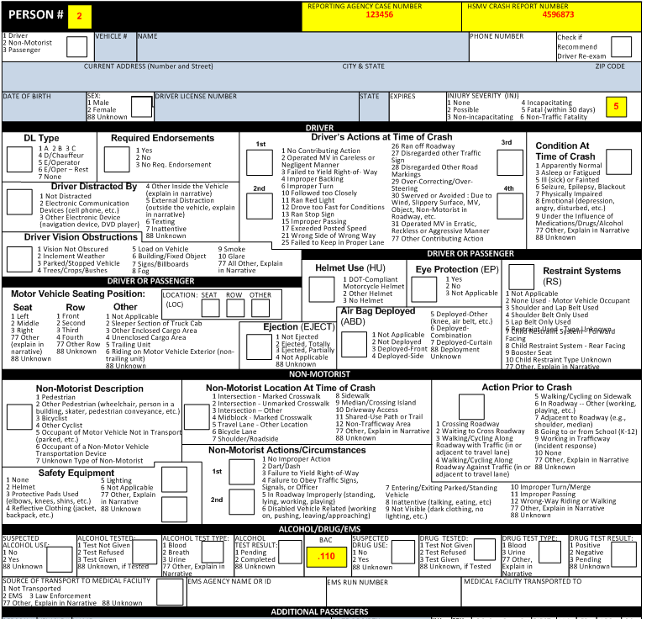
Updates: Case Example - Person
Update
1
2

Slide 39
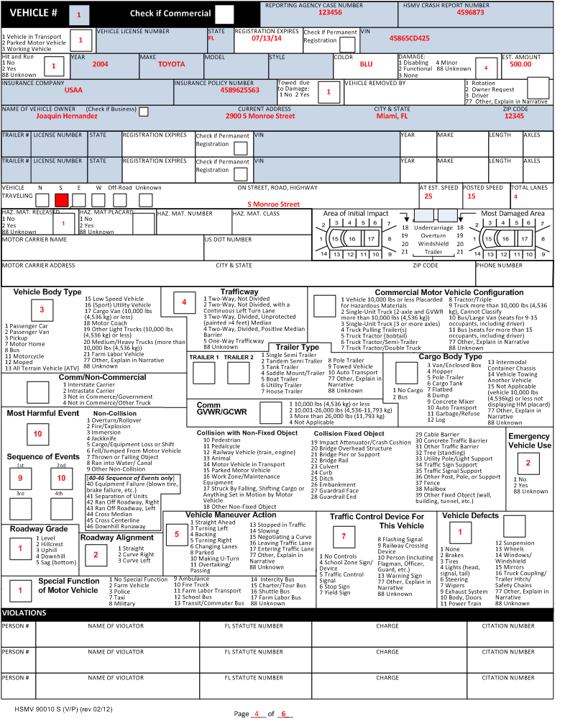
Updates: Case Example - Vehicle
Original
No update is required for this page.

Slide 40
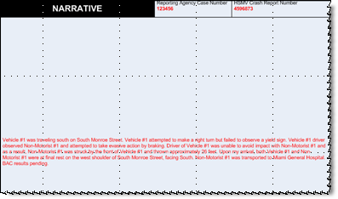
Updates: Case Example - Narrative
Original
Vehicle #1 was traveling south on South Monroe Street. Vehicle #1 attempted to make a right turn but failed to observe a yield sign. Vehicle #1 driver observed Non-Motorist #1 and attempted to take evasive action by braking. Driver of Vehicle #1 was unable to avoid impact with Non-Motorist #1 and as a result, Non-Motorist #1 was struck by the front of Vehicle #1 and thrown approximately 26 feet. Upon my arrival, both Vehicle #1 and Non-Motorist #1 were at final rest on the west shoulder of South Monroe Street, facing South. Non-Motorist #1 was transported to Miami General Hospital. BAC results pending.

Slide 41
Updates: Case Example - Narrative
Update
Update: Person #1 succumbed to injuries sustained in the crash and died on 01/12/12 at Miami General Hospital. BAC results were .110.

Slide 42
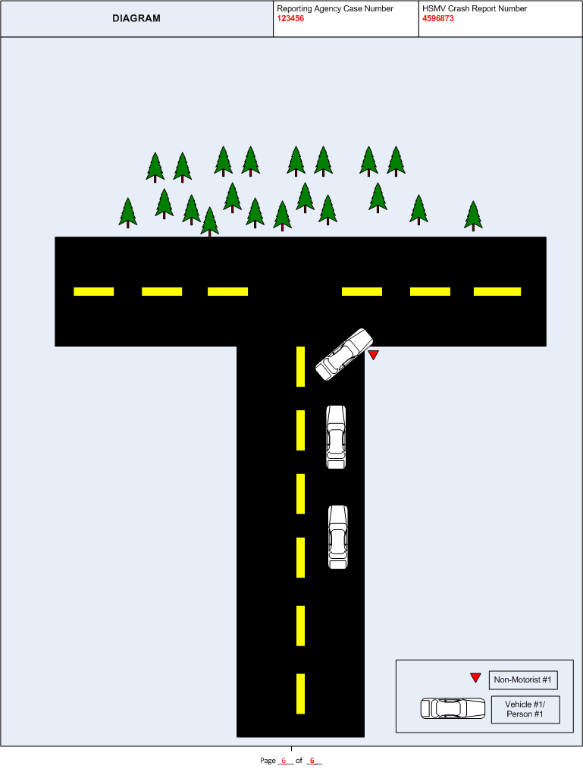
Updates: Case Example - Diagram
Original
No update is required for this page.
Vehicle #1/
Person #2

Slide 43
Common Crash Reporting Errors

Slide 44
When completing a crash report:
If the crash is not a ‘Hit and Run,’ the vehicle owner information is required. ‘Same as Driver’ is not acceptable.
A ‘Legally Parked Motor Vehicle’ cannot have a driver.
When entering a person’s name, both their first and last names must be recorded.

Slide 45
When completing a crash report:
When entering data for a Non-Motorist, the following fields are required:
Non-Motorist Location at Time of Crash
Action Prior to Crash

Slide 46
Common mailed crash report errors:
Duplicate crash numbers
No HSMV number
Illegible reports
Driver information added for a parked car

Slide 47
Commercial Motor Vehicle Crash Record Reporting

Slide 48
Truck and Bus Crashes Reportable to the Federal Motor Carrier Safety Administration (FMCSA)

Slide 49
FMCSA and Florida have a goal to reduce the number and severity of crashes involving trucks, buses and all motor vehicles with hazardous materials in both interstate and intrastate commerce.

Slide 50
Regulates motor carriers’ authority to operate through:
Roadside inspections
Motor carrier compliance reviews
Commercial driver licensing programs
Collects and studies crash data involving trucks and buses.

Slide 51
FMCSA’s Commercial Motor Vehicle Definition
A commercial motor vehicle is any self-propelled or towed vehicle used on the public highways in commerce to transport passengers or cargo if such vehicle:
Has a gross vehicle weight rating or gross combination weight rating or gross vehicle weight or gross combination weight of 4,536 kg (10,001 pounds) or more, whichever is greater; or
Is designed or used to transport more than 8 passengers (including the driver) for compensation; or
Is designed or used to transport more than 15 passengers (including the driver), and is not used to transport passengers for compensation; or
Is used in the transportation of materials found by the Secretary of Transportation to be hazardous and transported in a quantity requiring placarding.

Slide 52
FYI: Reportable Crashes to FMCSA
Vehicle
Crash
Weight
>10,000 lbs.
GVWR or GCWR
Fatality
or
or any
Passenger Capacity
9+ including driver
Qualifying Vehicle
Injury
Taken for treatment
or
or any
Hazardous Materials
Placard
Tow Away
With disabling damage

Slide 53
Interstate Commerce
Interstate Commerce is defined as trade, traffic or transportation in the United States:
Between a place in a State and a place outside of such State (including a place outside of the U.S.)
Between two places in a State through another State or a place outside of the U.S.
Between two places in a State as part of trade, traffic or transportation originating or terminating outside the State or the U.S.
Vehicles engaged in Interstate Commerce are required to have a US DOT#.

Slide 54
Intrastate Commerce
Intrastate Commerce is defined as trade, traffic or transportation that operates entirely within a State.
Intrastate Commerce carriers are NOT required to have a U.S. DOT Number
Not in Commerce- Government
Any government vehicle operated by local, state or federal government.
Not in Commerce- Other Trucks
Personal rental vehicles (U-Haul, Penske, etc.) over 10,000 lbs. GVWR/GCWR operated by a private individual.

Slide 55
Qualifying Commercial Motor Vehicles - Examples
A trucking company or individual owner/operator hauling the goods of a business for a fee. (For-Hire Carrier)
A manufacturing company hauling its own products to retail stores, or a retail store delivering products to its buyers.
A farm hauling its produce to or from the market.
If the vehicle is in commerce, it qualifies to be reported to FMCSA regardless of the circumstances.

Slide 56
Qualifying Commercial Motor Vehicles - Examples
A motor coach, airport shuttle, or hotel-owned shuttle bus or limousine service transporting passengers.
A government-owned truck or bus.
A school bus transporting students to/from school or school-related activities.

Slide 57
Private Use Vehicles (Not Reported to FMCSA)
Private use vehicles are defined as personally-owned trucks or passenger vehicles meant for personal use only, even if greater than 10,000 lbs.
Examples of private use vehicles include:
A non-commercial, individual horse owner transporting hay bales from his pasture on one side of the road to his stables on the other side in a truck with a GVWR greater than 10,000 lbs.
A homeowner carrying recyclables to a drop-off point in a personally owned pickup truck with a GVWR greater than 10,000 lbs.

Slide 58
Private Use Vehicles (Not Reported to FMCSA) (cont)
A family of 10 persons taking a trip in the family’s 12-passenger van.
A personally owned pickup truck hauling a boat, camper, horse, or utility trailer with a GCWR in excess of 10,000 lbs. not operating in commerce or as part of a business.
A family operating a personally owned and registered recreational vehicle or motor home in excess of 10,000 lbs. GVWR.

Slide 59
Crash Severity
Crashes are reportable to FMCSA that result in:
A fatality: ANY person(s) killed in or outside of any vehicle (truck, bus, car, etc.) involved in the crash or who dies within 30 days of the crash as a result of an injury sustained in the crash.
An injury: ANY person(s) injured as a result of the crash who immediately receives medical treatment away from the crash scene.

Slide 60
What is the meaning of ‘immediate medical attention?’
A person who immediately receives medical attention and is transported directly from the scene of an crash to a hospital or medical facility.
Must a person who is injured in an crash be transported to a treatment facility in an ambulance?
No. Any type of vehicle may be used to transport an injured person from the crash scene to a treatment facility.

Slide 61
Disabling Damage/Assistance vs. Towing
Crashes are reportable to FMCSA that result in:
A tow-away: ANY motor vehicle (truck, bus, car, etc.) disabled as a result of the crash and transported away from the scene by a tow truck or other vehicle.

Slide 62
Disabling Damage/Assistance vs. Towing
Disabling Damage: Damage that precludes departure of a motor vehicle from the scene of the crash in its usual manner in daylight after simple repairs.
Inclusions
Damage to motor vehicles that could have been driven, but would have been further damaged if so driven.
Exclusions
Damage that can be remedied temporarily at the scene of the crash without special tools or parts.
Tire disablement without other damage even if no spare tire is available.

Slide 63
Identifying the Responsible Motor Carrier

Slide 64
Definitions: Motor Carrier
Motor Carrier: the business entity, individual, partnership, corporation, or religious organization responsible for the transportation of goods, property or people.
For-Hire Carrier: a person engaged in the transportation of goods or passengers for compensation.
Private Motor Carrier: a person who provides transportation of property or passengers, by commercial motor vehicle, and is not a for-hire motor carrier.

Slide 65
Ways to Identify Motor Carriers
Driver Interview:
Are you the Motor Carrier responsible for this load? If not, who is?
Is the name and USDOT# on the side of your vehicle that of the motor carrier?
What documentation do you have on board to verify the motor carrier?
Are your services leased to another carrier?
Are you using a cargo broker?
Where is the motor carrier’s principle place of business?

Slide 66
Additional Ways to Identify Motor Carriers
Additional ways to identify motor carriers include:
Shipping papers
Lease/rental agreements
Driver’s log
Vehicle registration
Most often, the required information can be found on the driver’s side door.
To ensure that the crash is applied to the appropriate motor carrier’s record, this information is essential:
Full carrier name
Physical address
USDOT#

Slide 67
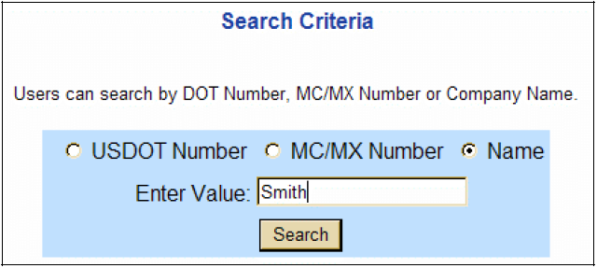
Common Problems in Identifying the Correct Information
Shipping papers are only required for hazardous material cargo.
Driver may say that there are no shipping papers or trip manifest, even when they may be in the vehicle.
USDOT# is not available on the shipping papers or the driver’s log for the carrier responsible for the load.
Use the Safer Website (link below) to help identify correct motor carrier information. Enter the name Smith.
http://safer.fmcsa.dot.gov/CompanySnapshot.aspx

Slide 68
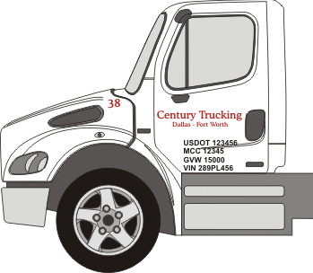
Marking of CMVs
The CMV marking must display:
Legal or a single trade name of the CMV
Motor carrier ID number, preceded by “USDOT”
If the name of any person other than the operating carrier appears, the name of the operating carrier must appear and be preceded by ‘Operated By’
Other identifying information may be displayed on the vehicle if it is not inconsistent with the information required

Slide 69
Rented and Leased CMVs
Trip and long-term leasing can cause the names and numbers on the door of a CMV to be different from the names on the shipping papers.
A company can lease a tractor(s) or the owner’s services to pull its load with the company’s trailer(s).
The carrier name and the USDOT# on the driver’s side of the tractor may be for the owner of the tractor(s), not the company responsible for the load. (This also applies to leased single-unit trucks.)

Slide 70
Rented and Leased CMVs
A short-term rental agreement for less than 30 days is required to be inside the vehicle.
A carrier is required to have the carrier’s name and USDOT# on the side of the vehicle within 30 days of a long-term lease. The USDOT# should also appear on the lease agreement or the outside of the vehicle (even if the rental period is less than 30 days).
A company can extend a short-term lease in an effort to keep from adding the company name and USDOT# on the vehicle.

Slide 71
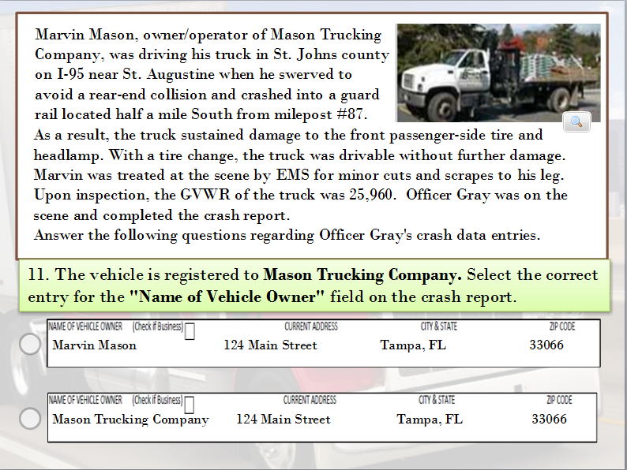
71
Notes:
Click over the correct answer

Slide 72
CMV Scenarios
Next we will discuss 3 CMV scenarios.

Slide 73
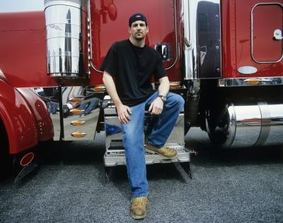
Scenario 1:
Who is the Motor Carrier?
A. John Smith
B. White Manufacturing
John Smith owns his own truck tractor, operating under John Smith Trucking. He contracts with White Manufacturing to take one of its trailers loaded with its goods from New York to Los Angeles.

Slide 74
Scenario 2:
Who is the Motor Carrier?
A. John Smith
B. Polyester Chemical Co.
John Smith, driving his truck tractor, leases his services to Polyester Chemical Company. Polyester directs Smith to deliver a semi-trailer from New York to St. Louis.

Slide 75
Scenario 3:
Who is the Motor Carrier?
A. John Smith
B. ABC Trucking
C. XYZ Trucking
John Smith is driving a tractor owned by ABC Trucking that has been leased to XYZ Trucking. XYZ uses the tractor to pull XYZ trailers in its regular shipping service.

Slide 76
Commercial Driver’s License (CDL)

Slide 77
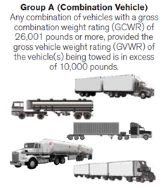
Group A (Combination Vehicle)
Any combination of vehicles with a gross combination weight rating of 26,001 lbs. or more, provided the gross vehicle weight rating of the vehicle(s) being towed is in excess of 10,000 lbs.

Slide 78
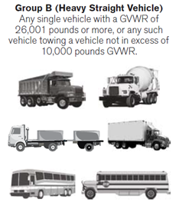
Group B (Heavy Straight Vehicle)
Any single vehicle with a gross vehicle weight rating of 26,001 lbs. or more, or any such vehicle towing a vehicle not in excess of 10,000 lbs. gross vehicle weight rating.

Slide 79
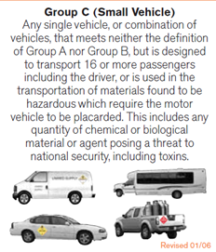
Group C (Small Vehicle)
Any single vehicle or combination of vehicles that meets neither the definition of Group A or Group B, but is designed to transport 16 or more passengers including the driver, or is used in the transportation of materials found to be hazardous which require the motor vehicle to be placarded. This includes any quantity of chemical or biological material or agent posing a threat to national security, including toxins.

Slide 80
Exemptions to Being Required to Have a CDL
Active duty military possessing a military license, operating a military vehicle.
Firefighters meeting approved training standards and operating authorized emergency vehicles.
Farmers
Individuals operating motor homes or other vehicles used exclusively to transport personal possessions or family members, for non-business purposes.

Slide 81
CDL Endorsements

Slide 82
Gross Vehicle Weight Rating (GVWR), Gross Combination Weight Rating (GCWR), Vehicle Configuration and Cargo Body Type

Slide 83
GVWR and GCWR
Gross Vehicle Weight Rating (GVWR) is the value specified by the manufacturer as the recommended maximum loaded weight of a single motor vehicle.
Gross Combination Weight Rating (GCWR) is the value specified by the manufacturer(s) as the recommended maximum loaded weight of a combination (articulated) motor vehicle.

Slide 84
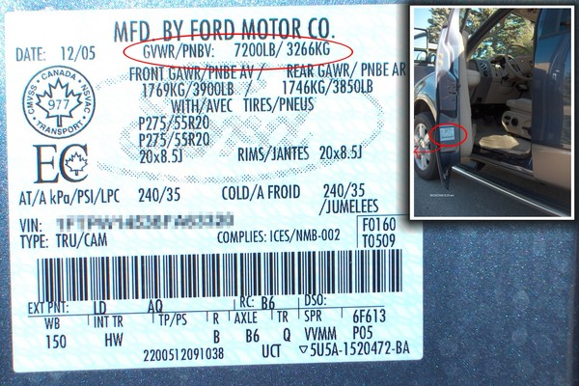
Where to Find the GVWR
The weight ratings, including GVWR, can be found on the certification label located on the:
driver’s door or door frame
cab behind driver’s seat
driver-side visor
Second-stage manufacturers may add an additional GVWR plate, which can be a yellow sticker located on the door frame.
To access a web-based VIN decoder for CMV’s, click this link:
www.nisrinc.com/cmv_id/cmv_id.asp
To access a web-based VIN decoder for non-CMV’s, click this link:
https://services.flhsmv.gov/MVCheckWeb/InquiryView.aspx

Slide 85
Vehicle Configuration

Slide 86
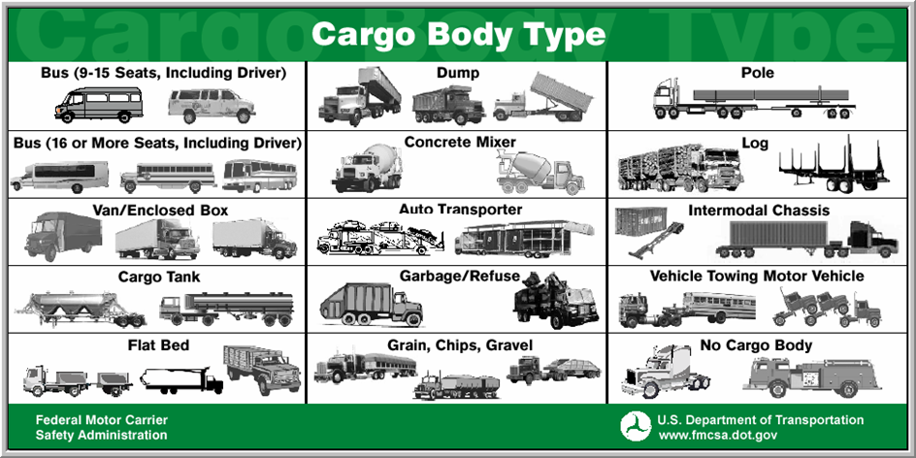
Cargo Body Type

Slide 87
CMV “Code Me” Challenge
Next, you will be given 10 CMV configurations. Select the best answer for each “Code Me” configuration.

Slide 88
Click on the correct answer.
88

Slide 89
Truck trailers are vehicle configurations consisting of any single-unit truck with an attached trailer for hauling cargo. When truck trailers possess 2 different cargo body types, select the cargo body type for the power unit (truck) in combination. If the truck has NO applicable cargo body type, use the trailer’s cargo body type. Truck trailers can include light trucks less than 10,000 lbs. that pulling trailers that increase the GCWR to over 10,000 lbs.
Click in the box to see the correct answer.
3
89

Slide 90
Click in the box to see the correct answer.
4
90

Slide 91
Click in the box to see the correct answer.
6
91

Slide 92
Truck trailers are vehicle configurations consisting of any single-unit truck with an attached trailer for hauling cargo. When truck trailers possess 2 different cargo body types, select the cargo body type for the power unit (truck) in combination. If the truck has NO applicable cargo body type, use the trailer’s cargo body type.
Click in the box to see the correct answer.
3
92

Slide 93
Truck trailers are vehicle configurations consisting of any single-unit truck with an attached trailer for hauling cargo. When truck trailers possess 2 different cargo body types, select the cargo body type for the power unit (truck) in combination. If the truck has NO applicable cargo body type, use the trailer’s cargo body type.
Click in the box to see the correct answer.
2
93

Slide 94
What is my Cargo Body Type?
I am specifically designed to transport multiple, fully assembled automobiles. Note: Single unit flatbeds transporting vehicles (i.e., flatbed tow truck, flatbed semi-trailer carrying wrecked/salvaged cars) DO NOT qualify and should NOT be coded as me in the Cargo Body Type field.
Click in the box to see the correct answer.
10
94

Slide 95
What is my Cargo Body Type?
My cargo body type can be without sides or a roof; with or without readily removable stakes, which may be tied together with chains, slats, or panels.
Click in the box to see the correct answer.
7
95

Slide 96
Truck Tractors and Semi-Trailers
A Truck Tractor is a vehicle configuration consisting of a power unit designed to pull a semi-trailer. The truck-tractor has no cargo carrying capability without the attached semi-trailer. A Semi-Trailer is constructed so that some part of the weight rests upon the power unit. A truck tractor towing another motor vehicle is considered a “truck tractor” vehicle configuration and the codes 5-8 should be used for these CMV configurations.
Click in the box to see the correct answer.
6
96

Slide 97
Click in the box to see the correct answer.
1
97

Slide 98
Hazardous Materials

Slide 99
Hazardous Materials - Definitions
Hazardous material: a substance or material which has been designated by the U.S. Department of Transportation, or other authorizing entity, as capable of posing an unreasonable risk to health, safety and property when transported in commerce.
Any motor vehicle transporting hazardous materials in quantities above the thresholds established by the U.S. Department of Transportation, or other authorized entity, is required to display a hazardous materials placard.
Hazardous materials number: the four-digit number from the placard located either on an orange panel or a white ‘square-on-point’ panel.

Slide 100
Hazardous Materials - Definitions
Hazardous materials placard: a sign required to be affixed to any motor vehicle transporting hazardous materials in quantities above the thresholds established by the U.S. Department of Transportation, or other authorized entity.
The placard identifies the hazard class division number, 4-digit hazardous material identification number, or the name of the hazardous material being transported.
Hazardous materials class number: a one or two-digit number with a decimal in the middle. The number is critical for identifying and studying various types of hazardous materials involved in traffic crashes.

Slide 101
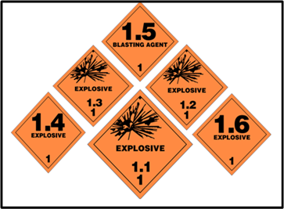
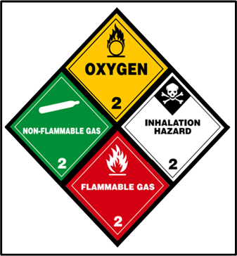
Nine Classes of Hazardous Materials
Class 1: Explosives
Class 2: Gases
Class 3: Flammable Liquid and Combustible Liquid
Divisions: 1.1, 1.2, 1.3, 1.4, 1.5, 1.6
Divisions: 2.1, 2.2, 2.3

Slide 102
Nine Classes of Hazardous Materials
Class 4: Flammable Solid, Spontaneously Combustible, and Dangerous When Wet
Class 5: Oxidizers and Organic Peroxide
Class 6: Poison (Toxic) and Poison Inhalation Hazard
Divisions: 4.1, 4.2, 4.3
Divisions: 5.1, 5.2

Slide 103
Nine Classes of Hazardous Materials
Class 7: Radioactive
Class 8: Corrosive
Class 9: Miscellaneous

Slide 104
Locating the 1-Digit Class Number
The class number is located at the bottom of the hazardous material placard.
The number may be a single-digit or two-digit number
with a decimal in the middle.
Class number should also be visible on the required shipping papers.
Class numbers presented with decimals, like 5.1, should be entered on the crash report as “5”

Slide 105
4-Digit ID Number
Is commonly referred to as the ‘UN’ or ‘NA’ number.
On cargo tanks the hazardous materials ID number may also be found on an orange panel adjacent to the placard.

Slide 106
Frequently Asked Questions
What is meant by ‘hazardous material released’?
Hazardous materials released: any material other than fuel or oil carried by the vehicle for its own use should be considered cargo. Fuel or oil carried by the vehicle for it’s own use is NOT considered cargo and should NOT be reported as ‘hazardous materials released’ on the crash report.
How do you report a crash involving cargo carrying multiple hazardous materials cargo?
If more than one hazardous material is being transported, record the information for the highest quantity of hazardous material transported.

Slide 107
Bulk Packages [Hazardous Materials]
Bulk package: a package with no immediate form of containment
Bulk packages must be placarded unless cleaned and purged.
A gas container that is empty, but has not been cleaned or purged, must remain placarded.
For containers with bulk packages inside, if the required ID# marking on the bulk package is not visible, the transport vehicle must be marked on each side and each end.

Slide 108
Harmful Events/ Sequence of Events

Slide 109
Harmful event: an occurrence of bodily injury or damage.
Exclusions:
Injury or damage resulting when a driver dies or loses consciousness because of a disease condition such as a stroke, heart attack, diabetic coma, or epileptic seizure.

Slide 110
FL Sequence of Events
Sequence of events captures harmful events and non-harmful events for each involved traffic unit.
Non-collision events (codes 1-9 and 40-46)
Collision with non-fixed objects (codes 10-18)
Collision with fixed object (codes 19-39)

Slide 111
Non-Collision Codes
Overturn/Rollover
Fire/Explosion
Immersion
Jackknife
Cargo/Equipment Loss or Shift
Fell/Jumped from Motor Vehicle
Thrown or Falling Object
Ran into Water/Canal
Other Non-collision
40. Equipment Failure (blown tire, brake failure, etc.)
41. Separation of Units
42. Ran Off Roadway, Right
43. Ran Off Roadway, Left
44. Cross Median
45. Cross Centerline
46. Downhill Runaway

Slide 112
Examples: Non-Collision Crashes
A vehicle overturns 90 degrees or more on its side or end-over-end.
Example: A 12-person church van slips sideways on a loose shoulder and flips on its passenger side on the right roadside injuring the occupants.
Injury or damage from a moving part of a vehicle in-transport; objects falling from, or in, a vehicle in-transport.
Example: A stake truck hauling lumber stops abruptly causing the lumber to slide into the cab, striking and injuring a passenger.

Slide 113
Collision with Non-Fixed Object
10. Pedestrian
11. Pedalcycle
12. Railway Vehicle (train, engine)
13. Animal
14. Motor Vehicle in Transport
15. Parked Motor Vehicle
16. Work Zone/Maintenance Equipment
17. Struck by Falling Shifting Cargo or Anything Set in Motion by Motor
Vehicle
18. Other Non-Fixed Object

Slide 114
Examples: Collision with Non-Fixed Object
Collision with a motor vehicle in-transport
Example: A step van towing a 7,000 lb. flatbed trailer becomes unhitched. The side of the trailer swipes the side of a dump truck traveling in the opposite direction on an undivided road causing disabling damage.
Pedestrian
Example: A broken down truck tractor on the shoulder starts to roll forward striking and injuring its driver, who was looking under the hood.

Slide 115
Collision Fixed Object
19. Impact Attenuator/Crash Cushion
20. Bridge Overhead Structure
21. Bridge Pier Support
22. Bridge Rail
23. Culvert
24. Curb
25. Ditch
26. Embankment
27. Guardrail Face
28. Guardrail End
29. Cable Barrier
30. Concrete Traffic Barrier
31. Other Traffic Barrier
32. Tree (standing)
33. Utility Pole/Light Support
34. Traffic Sign Support
35. Traffic Signal Support
36. Other Post, Pole, or Support
37. Fence
38. Mailbox
39. Other Fixed Object (wall, building,
tunnel, etc.)

Slide 116
Examples: Collision with Fixed Object
Bridge Overhead Structure
Example: A truck with a tall load attempts to go under a bridge, striking the overhead structure.
Guardrail Face
Example: A driver of a truck tractor falls asleep at the wheel, causing his vehicle to strike the front portion of the guardrail.

Slide 117
Case Exercise Example
On the next slide you will be given a Crash Case that will require completion of several items on the Event, Person, and Vehicle pages of a Crash Report.

Slide 118
Case Exercise Example
An old tree started to fall across Kemp Road. Drivers of Unit #1 and Unit #2 saw the tree falling. Driver #1 slammed on the brakes and Driver #2 swerved to try to avoid it.
Unit #1, a Peterbilt tandem tank truck pulling a tank trailer, was struck by the tree causing damage to the cab. The vehicle then jackknifed and the tank trailer overturned, causing hazardous material to spill on the roadway and catch fire. Driver #1 was seriously burned.
Unit #2 was a GMC single-unit flatbed carrying building supplies traveling at a high rate of speed. Driver #2 attempted to avoid the falling tree and drove into the guardrail and then collided with the tree, which had fallen in its path. Unit #2 was then forced airborne, rolled over, and came down on Unit #3, a state-owned dump truck carrying sand, traveling behind Unit #1. Driver #2 was killed from being ejected during the rollover.
Driver #1 and Driver #3 received incapacitating injuries and were transported for treatment to Tampa General Hospital by American Medical Response in the same unit.
Vehicles #2 and #3 were towed by Tow-mater Towing Service due to disabling damage and Vehicle #1 was towed by Sam’s Wrecker Service.

Slide 119
What is the First Harmful Event?
What was the Injury Severity in Vehicle #1? #2?
What is the Commercial Motor Vehicle Configuration of Vehicle #1?
What is the Cargo Body Type of Vehicle #1?
What would be the correct way to code the Sequence of Events for Vehicle #1?

Slide 120
Recording Truck and Bus Information for Non-Contact Vehicles
Truck/Bus information SHOULD be recorded when:
A CMV is a non-contact vehicle and is included on the State Crash Report as an involved unit in the crash by the officer and may be identified as ‘at-fault’ and/or charged by the officer for an offense.
Example: A tractor trailer runs a red light at an intersection causing a motorcycle driver to lay down the motorcycle, injuring the driver, without striking the truck. The tractor trailer is recorded as a traffic unit on the report and determined to be the “at-fault” vehicle.

Slide 121
Recording Truck and Bus Information for Non-Contact Vehicles
Truck/Bus information SHOULD NOT be recorded when:
A CMV is a non-contact vehicle and is not included on the State Crash Report as an involved unit in the crash by the officer. Then the Truck/Bus information should NOT be recorded.
In this situation the vehicle may have left the scene or be at the scene and recorded on the State Crash Report as a witness in the crash.

Slide 122
Recording Truck and Bus Information for Non-Contact Vehicles
Examples:
A crash occurs between two non-CMVs in front of a CMV. The CMV avoids contacting the vehicles or anything else but stops at the scene to provide assistance or act as a witness.
A CMV changes lanes and a vehicle behind the CMV loses control striking a fixed object. The CMV continues on or stops at the scene and the police determine that the CMV is not at fault or involved.

Slide 123
Recording Truck and Bus Information for Parked CMVs or Stopped CMVs Off the Roadway
Parked Motor Vehicle - A motor vehicle not in transport.
A vehicle ‘in-transport’ is a vehicle which is in motion within the trafficway or on the roadway. To be ‘parked’ the vehicle must be legally parked off the roadway.

Slide 124
CMV Crash Scenarios
On the next slide we will discuss 3 CMV crash scenarios containing 2 questions each.

Slide 125
Recording Truck and Bus Information for Parked CMVs or Stopped CMVs Off the Roadway
Scenario 1:
Is this a motor vehicle traffic crash?
Should the truck data be reported to SAFETYNET?
A tractor/semi-trailer is stopped on the shoulder of an open trafficway, with or without a driver, and is struck in the rear by a car which runs off the roadway. The car is towed due to disabling damage.

Slide 126
Recording Truck and Bus Information for Parked CMVs or Stopped CMVs Off the Roadway
Scenario 2:
Is this a motor vehicle traffic crash?
Should the truck data be reported to SAFETYNET?
A 26,000 lb. single-unit truck is stopped at a gas pump in a gas station off the trafficway. A second 16,000 lb. single-unit truck loses control in the travel lane, runs off the road and enters the gas station striking the truck at the pump causing injury to both drivers, requiring immediate transportation to a hospital.

Slide 127
Recording Truck and Bus Information for Parked CMVs or Stopped CMVs Off the Roadway
Scenario 3:
Is this a motor vehicle traffic crash?
Should the truck data be reported to SAFETYNET?
A tractor/semi-trailer is stopped in a designated parking lane on a ramp to a rest area. The driver begins to pull forward in an effort to leave the parking space. The vehicle strikes and injures a pedestrian standing behind a truck parked in the space in front of the tractor/trailer. The pedestrian is transported to a medical treatment facility.

Slide 128
Additional Resources:
Court Assist:
http://flhsmv.gov/courts or call (850) 617-2589
FMCSA Company Snapshot:
http://safer.fmcsa.dot.gov/CompanySnapshot.aspx
National Institute for Safety Research and FMCSA CMV ID 4.0 (accessing CMV VIN & Safetynet Crash Data):
www.nisrinc.com/cmv_id/cmv_id.asp
Florida Department of Highway Safety and Motor Vehicles
(accessing VIN and GVWR for non-CMV vehicles)
https://services.flhsmv.gov/MVCheckWeb/InquiryView.aspx

Slide 129
Additional Resources: (continued)
The FIRES Portal is a valuable resource for accessing traffic accident reports completed by Florida law enforcement agencies. To gain access, contact:
FIRES Portal website: https://firesportal.com
Phone: (866) 495-4206
Email: fires@appriss.com

Slide 130
Provide Feedback for this Course:
Thank you for taking this Training.
We are interested in your feedback!
Send your comments, questions, concerns, or any input you
may wish to provide us!
Email us at:
Courtassist@flhsmv.gov

